Slide 1
EFFECTS OF MALARIA CO-INFECTION WITH EPSTEIN-BARR VIRUS, A KEY CONTRIBUTOR IN ENDEMIC BURKITT CANCER DEVELOPMENT. A CASE STUDY IN CHILDREN UNDER 9 YEARS IN WESTERN KENYA
Kitungulu Nicholas, MSc (Medical Biotechnology)
PhD cand( Maseno University)
Notes:
I was looking at p.f, NK cells, eBL in Children (aged 9 yrs) in western Kenyan which lies along the equatorial tropics where malaria is holoendemic, this region is experienced with chronic and intensive malaria transmission throught the year.{ Ndenga 2006 Wafula, Githeko}

Slide 2
INTRODUCTION
eBL the most common pediatric cancer in equatorial regions
Holoendemic malaria exposure is associated with highest EBV titers and younger age of primary EBV infection compared to children not exposed to malaria and older children(Moormann, JID 2005; Piriou, JID 2012).
Seminal studies (Asito) have shown that T and B cells are modulated during EBV-malaria co-infection, however the role of innate immunity is unknown.
Previous studies, have shown that children below 5 years of age from malaria holoendemic regions have deficient T cell IFN-γ response to EBV antigens and especially EBNA1 as well high EBV viral loads
EBNA1 is the only EBV antigen expressed by EBV associated tumors as well as infected cells (Leight & Sugden, 2000) and hence the quality of immune responses to this antigen may shed important clues in etiology of eBL.
Notes:
eBL> most common, and account to over 74% of African pedriatic cancer. (MacArthur 2007)
2 ubiquitous agents, EBV and P. falciparum involved in its etiology. In the African, about 99% get infected with EBV by the age of 6 month. While in developing countries most individuals are infected during adolescence. The disease has high proliferative index that is its tumor doubling characteristic within 24 hours and its high prevalence (1:10,000) at this regions hence of great public health. Peak incidence age of 4-9 years. The exact etiological mechanisms underlying eBL, remains unknown.
Children from malaria holoendemic regions have been shown to have dysfunctional T cell in respect to immune control of EBV latent and lytic antigens (Moormann et al., 2007) . The immunomodulatory role of P. falciparum on NK cell function has not been studied in the context of EBV infection and eBL lymphomagenesis.

Slide 3
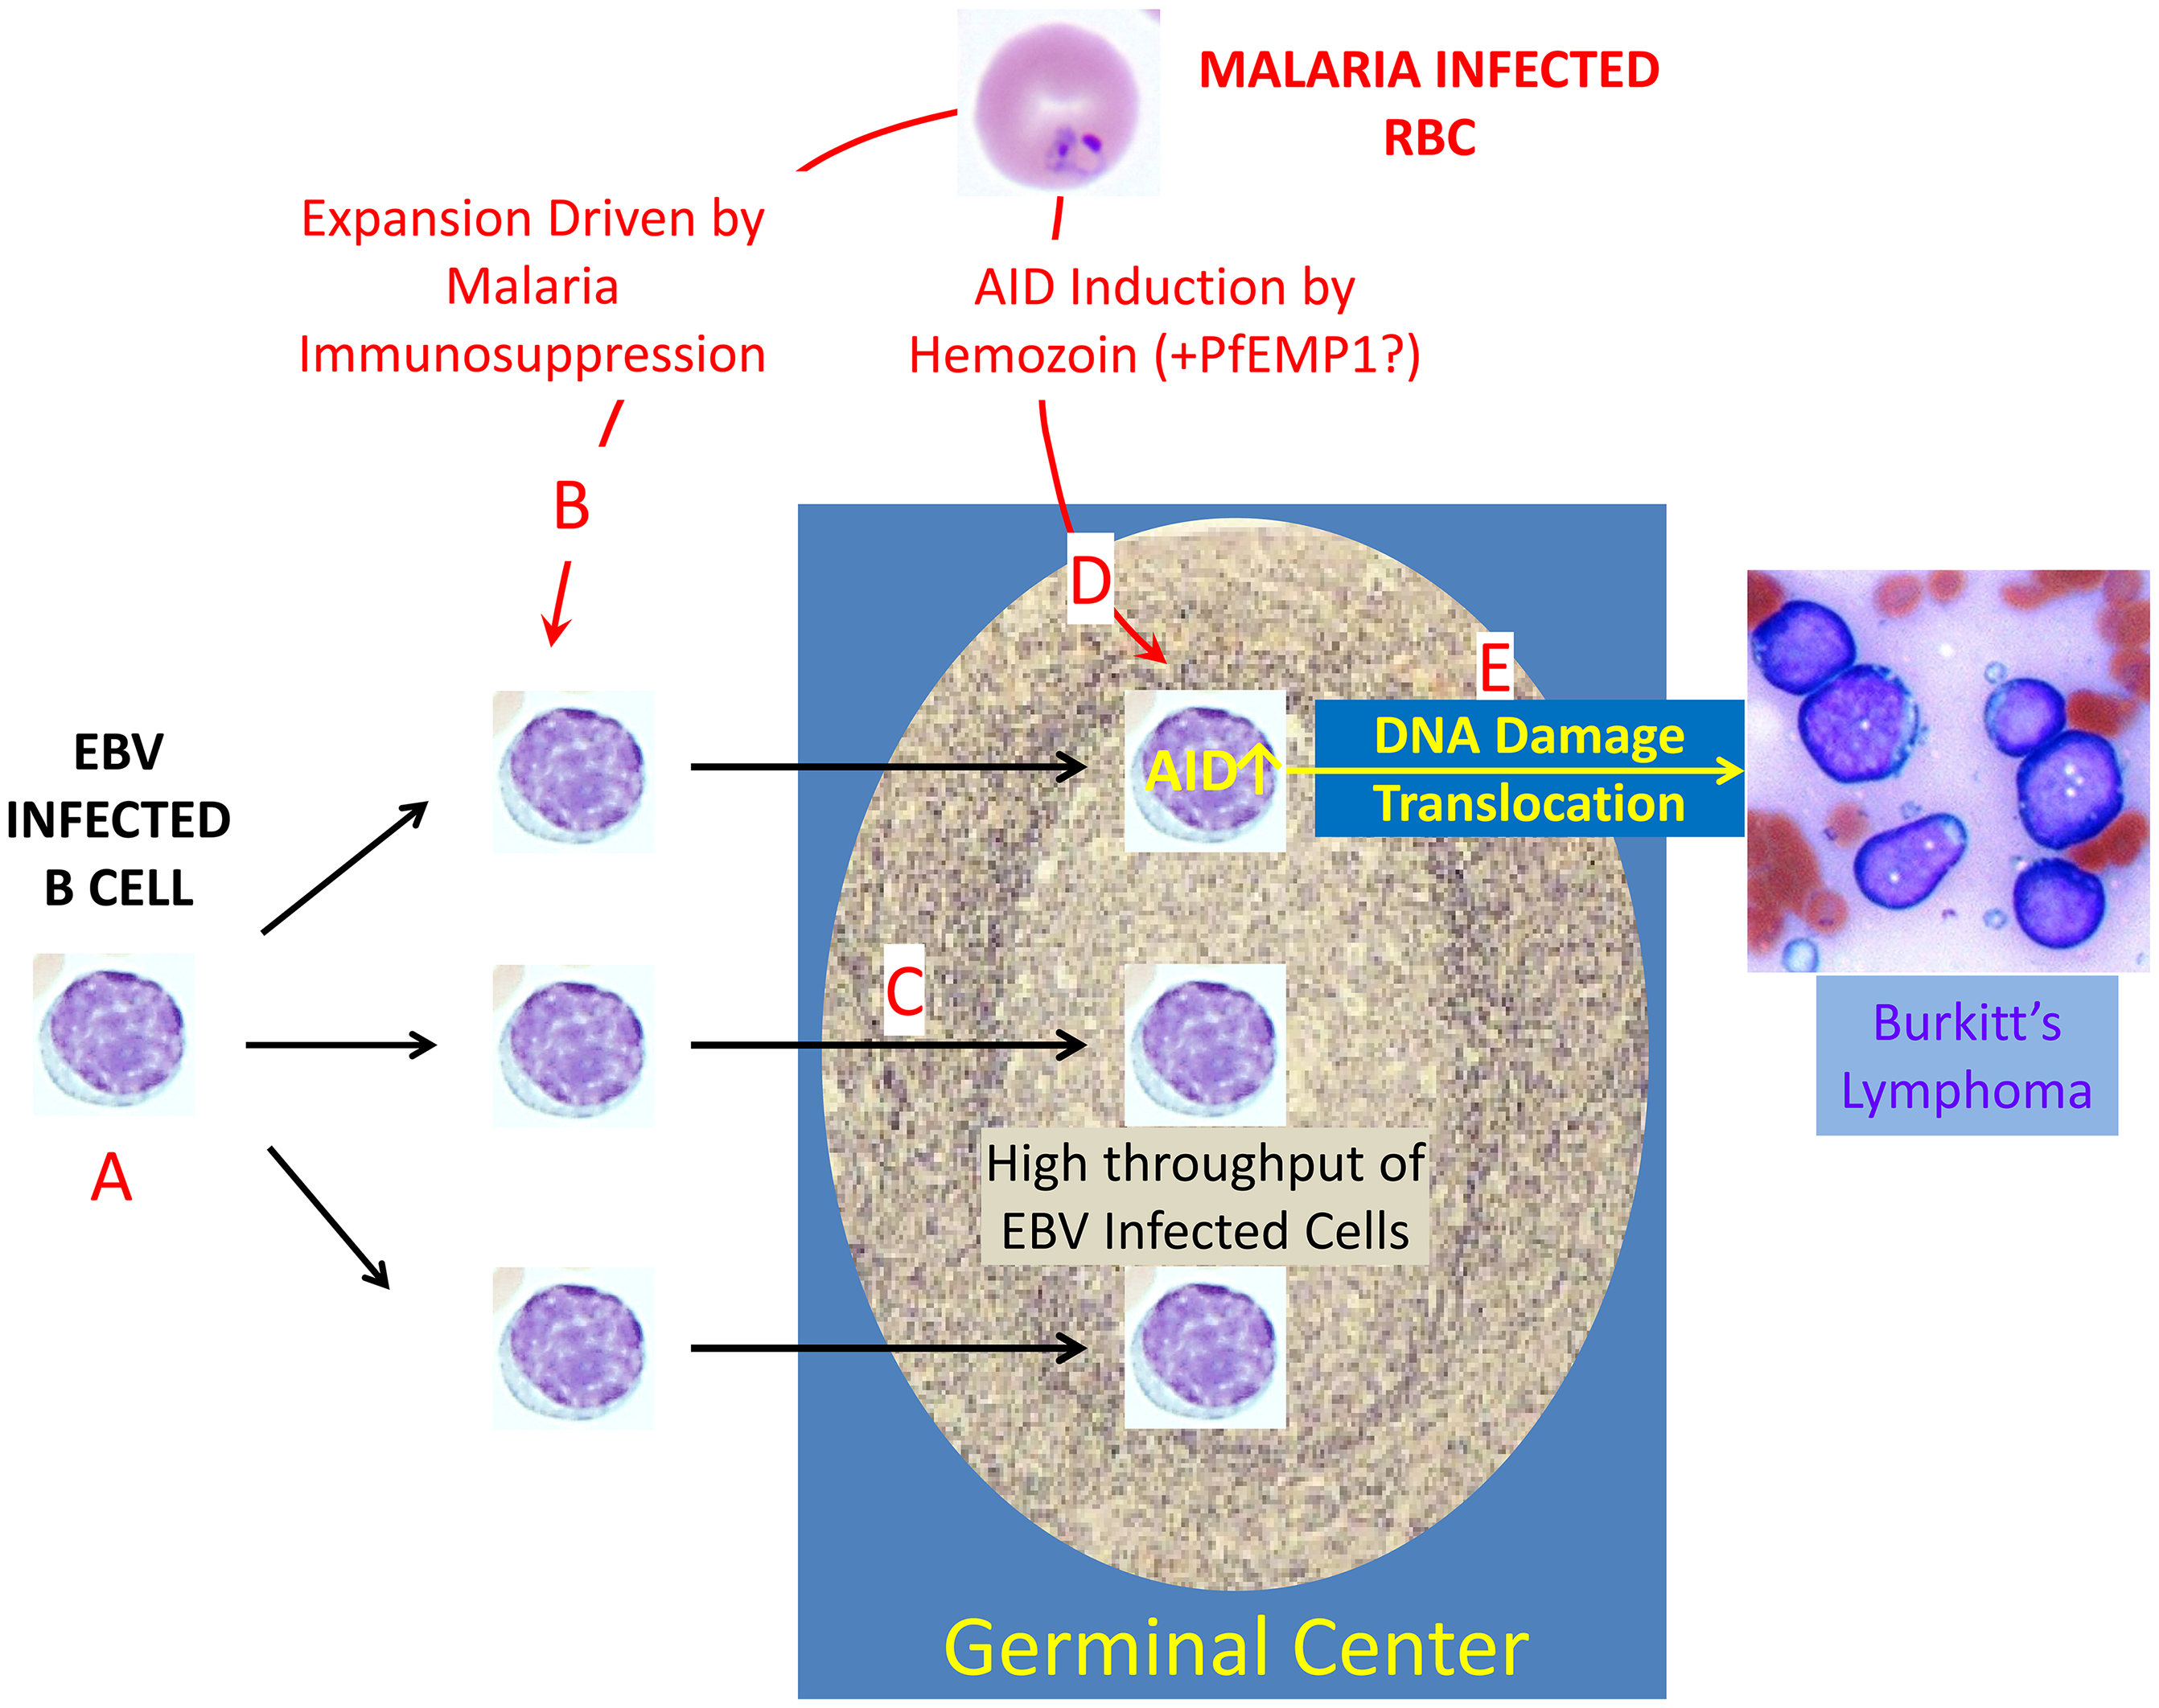
Schematic representation of the interaction between P falciparum, B cells and EBV in the etiology of eBL (adapted from Thorley-Lawson et al., 2016).
Notes:
AID; Activation-Induced cytidine Deaminase. Essentially all adults are persistently infected with EBV (A). As a consequence, newly infected B cells are continually being produced that transit the germinal center on their way to becoming latently infected memory B cells (the site of viral persistence). Malaria is immunosuppressive and has shown that this results in a highly elevated throughput of EBV-infected cells in the Germinal center, also showed that P. falciparum induces deregulated expression of the DNA-mutating and -cutting enzyme AID in germinal center cells. Subsequently showed in a mouse model that this deregulated expression led to DNA damage, translocations, and, ultimately, lymphoma. Thus, infection with P. falciparum malaria has been shown to have two effects on the germinal center, where eBL originates. Together, these increase the risk that a germinal center cell will undergo a c-myc translocation and that this cell will also be EBV-infected and, therefore, able to tolerate the translocation, synergistically increasing the likelihood of eBL cancer development.

Slide 4
Signs and symptoms
Enlarged lymph nodes
Fever
Sweating glands
Weight loss
Fatigue (extreme tiredness)
Swollen abdomen (belly)
Chest pain or pressure
Shortness of breath or cough
Severe or frequent infections

Slide 5
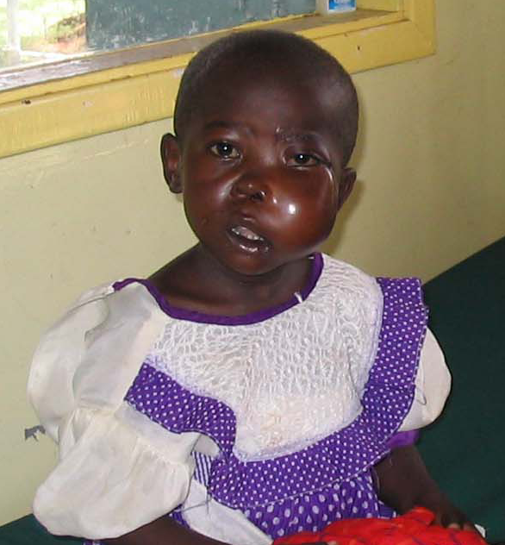
Rochford, Cannon, Moormann NatRevMicro 2005

Slide 6
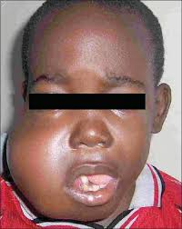

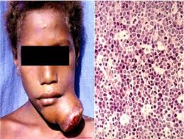
Adopted from: http://cancer2858.blogspot.com/2012/01/Burkitt-lymphoma.html

Slide 7
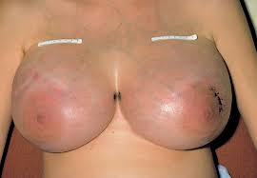
adopted from http://www.ografoundation.org/project/burkitts.html

Slide 8
PROBLEM STATEMENT
Central role of NK cell in primary EBV infection control and immunomodulatory role of P. falciparum transmission in adaptive immunity has well been studied (Williams et al., 2005; Asito et al., 2008)
However, role of P. falciparum transmission on NK cells(innate immunity) activities on EBV has not been determined.

Slide 9
OBJECTIVES OF THE STUDY
Main Objective
To study the association between Plasmodium falciparum malaria transmission and Natural Killer cell function in the etiology of endemic Burkitt lymphoma in children from western Kenya.
Specific Objectives
To determine the frequencies of EBNA1-specific NK cell function (IFN-γ, Granzyme B, PD-1 and CD107a) due to P. falciparum transmission patterns in holoendemic and hypoendemic regions of western Kenya.
To determine the differences in EBV viral loads due to P. falciparum transmission patterns in malaria holoendemic and hypoendemic regions of western Kenya.
To determine the correlation between NK cell functional capacity and EBV viral loads in holoendemic and hypoendemic regions of western Kenya.

Slide 10
RESEARCH QUESTIONS
What are the frequencies of EBNA1-specific NK (IFN-γ, Granzyme B, PD-1 and CD107a) cells due to P. falciparum transmission patterns in holoendemic and hypoendemic regions of western Kenya?
What are the differences in EBV viral loads due to P. falciparum transmission patterns in malaria holoendemic and hypoendemic regions of western Kenya?
What is the correlation between NK cell functional capacity and EBV viral loads?
Notes:
My research Questions were derived from the specific objectives

Slide 11
SIGNIFICANCE OF THE STUDY
This study reports that there is possible immunomodulatory role of P. falciparum transmission on NK cell function in eBL genesis.
Thus there is need for combined clinical efforts in immune reconstitution of T, B and NK cells as one of the strategy to mitigate the effects/association of malaria in eBL etiology.

Slide 12
MATERIALS AND METHODS
Study design:
Inclusion criteria: <3.5 years, ≤37.5ºC., Permanent residents of Kisumu County or Nandi County,
Sample size (n):
= 42
Where:
Z_{β}= 80 (for study power of at least 80% which is acceptable for most biological studies)
Z_{α}=1.96 or 0.05 which stand for significance level
r =4 (one cases versus 4 controls since the incidence of eBL is rare. Nationally, the incidence of eBL is one for every 100,000 live births (Magrath et al, 1990)
σ=6.0 (3 standard deviations below and above the mean to capture at least 75% of the population distribution)
Differences = 4.69, between mean of EBV viral loads in Kisumu and eBL (According to Moormann et al., 2005).

Slide 13
MATERIALS AND METHODS
Sample Processing
Sample collection
Sample Processing
Objective one:
(1)-PBMC stimulation and culture preparations
2) Immunofluorescence staining and Flow cytometry analysis
Objective two:
EBV viral loads determination by RTQ-PCR detecting a 70-bp region of the EBV BALF5 gene
Objectives three:
Determine the correlation NK cells & EBV Viral loads was done by Linear regression analysis
Notes:
Samples were collected in the field and processed within 3 hours
Peripheral blood mononuclear cells (PBMC) – are typically isolated form whole human blood.

Slide 14
MATERIALS AND METHODS
Objective 1: Multiparameter flow cytometry
Stimulation Conditions: total overlapping peptides from EBNA1 and recombinant malaria surface protein, MSP-1. Unstimulated PBMCs were used as negative control.
Antibody panel: fluorophore-conjugated monoclonal antibodies to
NK cell lineage markers CD56
Functional markers: intracellular staining (ICS) for IFN-γ, CD107a, GrB
Other markers: Activation/Exhaustion marker: PD-1
Dump Channel: CD3, CD14, CD19, live-dead stain
Notes:
Isolation of PBMC was done by Ficoll-hypaque gradient centrifugation
Cells were plated for cultures then EBNA1 and MSP1 peptides/antigens were introduced
Stimulation of cell culuters by 10ul of SEB, after 4 hours of incubation at 37 Golgi plug was added to trap the intracellular cytokines
∗Advantage of this method is simultaneous evaluation of NK cell profiles when sample volume is limited, as it occurs in studies of children.
Surface staining for CD3 markers for Tcell, CD19 for B cells and 56 CD for NK cells was done for twenty minutes in dark at room tempts
PBS added, then cytofix solution was added to each sample then again incubated for 30mins in darkness at room tempts then flow cytometry performed.
Intracellular staining
For INFy, GrB, CD107a, and PD1 was done, then flow cytometry performed
cells were then harvested and stained with a panel of fluorochrome-conjugated antibodies for flow cytometer analysis
FACSCanto flow cytometer (BD Biosciences, San Jose, CA, USA

Slide 15
MATERIALS AND METHODS
Objective 2: EBV Viral Loads Determination
Mean parasitemia densities between different groups was investigated by ANOVA.
Viral EBV DNA extraction was done by use of QIAGEN DNA extraction kit
EBV viral loads were determined from both the cases and controls by use of RTQ-PCR
Primers and probes were designed using Primer Express software (version 2.0;PE Applied Biosystems)
EBV viral load was normalized to the number of β-actin copies and then calculated on the basis of copies of EBV genome per ug of DNA (Moormann et al., 2005)
Notes:
70-bp region of the EBV BALF5 gene (Kimura et al., 1999). A standard curve was generated by extracting DNA from Namalwa BL cell lines (ATCCCR1-1432) that contains 2 integrated copies of EBV genome per cell.
β-actin was run as positive PCR control using commercially available probes and primers (PE Applied Biosystems) to standardize the method

Slide 16
MATERIALS AND METHODS
Objective 3: NK cell functional capacity and EBV viral loads.
Linear regression analysis was used to investigate the association between frequencies of EBNA-1 specific NK cells and EBV viral loads.
Notes:
Linear regression analysis was used to analyze the relationship between the frequencies of EBNA-1 specific NK cells and EBV viral loads
Linear regression is a powerful technique used for predicting the unknown value of a variable from the known value of another variable
Before analysis, the data was normalized by log transformation then subjected to
Kruskal-Wallis /one way ANOVA test is a nonparametric test that compares three or more unmatched groups
Dunn’s multiple comparison test (nonparametric) was used to compare differences between any two groups. All tests were two tailed with the critical limit being p≤ 0.05 for significance.

Slide 17
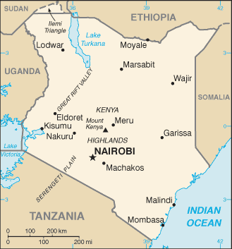
MATERIALS AND METHODS
Study Site
low malaria Risk
Stable Endemic
Kenya map showing the two study sites where samples were drawn from. Downloaded courtesy of the National Geographic Maps http://maps.nationalgeographic.com/maps)
Notes:
Mosoriot (highlands) found in, Nandi County is in a region of sporadic (low and unstable) malaria endemicity with an altitude of over 3000m
Chulaimbo (lowlands), located near the shores of Lake Victoria in Kisumu County, holoendemic (chronic and intense) transmission patterns (Bloland et al., 1999) and has high prevalence rates of eBL (Rainey et al., 2007a; Rainey et al., 2007b). This area is located at an altitude of about 1133m

Slide 18
RESULTS
Study participants’ demographics characteristics
Study Site | P. falciparum Exposure | Sample size (n) | Gender n (%) |  | Mean parasitemia
 |  |  | Male | Female
BL | Holoendemic | 10 | 7 (70%) | 3 (30%) | 44.45
Kisumu | Holoendemic | 16 | 8 (50%) | 8 (50%) | 3800.33
Nandi | Hypoendemic | 16 | 8 (50%) | 8 (50%) | 77.89
Total |  | 42 | 23 (55%) | 19 (45%)
p value |  |  |  |  | 0.018
BL, Burkitt's Lymphoma
Notes:
Summary of demographic characteristics of study participants. Differences in mean parasitemia by ANOVA. Significant values (p<0.05). Gender represented as raw scores with percentages in parenthesis (ANOVA is a non parametric )

Slide 19
RESULTS
Frequencies of EBNA1-specific NK cell function (IFN-γ, Granzyme B, PD-1 and CD107a) due to P. falciparum transmission patterns in holoendemic and hypoendemic regions of western Kenya
A; EBNA-1
B; MSP-1
Fig. 1 A and B ; Frequency of EBNA-1, MSP-1 IFN-γ specific NK cells
EBNA-1, Epstein Barr Nucleotide antigen 1; IFN-γ, Interferon gamma; NK, Natural Killer Cells; MSP-1, Malaria surface protein 1.
Notes:
GraphPad Statistics(Nonparametric)
Frequency of IFN-γ producing EBNA1-specific NK cells was higher in Nandi and Kisumu children, and least in eBL children

Slide 20
RESULTS
A; EBNA-1
B; MSP-1
Fig. 2 A and B Frequency of EBNA-1 specific CD107a NK specific cells
EBNA-1, Epstein Barr Nucleotide antigen 1; CD, Cluster of Differentiation 107a; NK, Natural Killer Cells; MSP-1, Malaria surface protein 1.
Notes:
It was observed that children presenting with eBL had the least CD107a EBNA1-specific NK cell response followed by Kisumu and lastly Nandi (p=0.0291). On the other hand, there were no significant differences in MSP-1 specific CD107a NK cell response across the study groups.

Slide 21
RESULTS
A: EBNA-1
B: MSP-1
Fig. 3 A and B; Frequencies of GrB Producing NK cells
EBNA-1, Epstein Barr Nucleotide antigen 1; GrB, Granzyme B molecule; NK, Natural Killer Cells; MSP-1, Malaria surface protein 1.
Notes:
no significant differences across the three study groups observed.

Slide 22
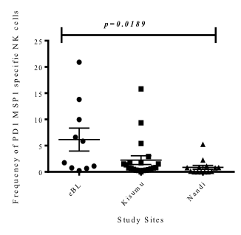
RESULTS
A, EBNA-1
B, MSP-1
Fig. 4 A and B Frequencies of PD-1 Producing NK cells
EBNA-1, Epstein Barr Nucleotide antigen 1; PD, Programmed cell death 1; NK, Natural Killer Cells; MSP-1, Malaria surface protein 1.
Notes:
Frequencies of PD-1 specific NK cells response against EBNA1 (panel a) and MSP-1
Differences in median frequencies between study groups were analyzed by Kruskall-Wallis test. Nandi Children recorded the least mean PD-1 MSP-1 specific NK cell response . The highest MSP-1 specific PD-1 response was recorded in the eBL children, followed by Kisumu participant. Similarly, children presenting with eBL had the highest PD1 EBNA-1 specific NK cell response followed by Kisumu and lastly Nandi. This difference was statistically significant, p=0.0103 (panel a).

Slide 23
RESULTS
Differences in EBV viral loads due to P. falciparum transmission patterns in malaria holoendemic and hypoendemic regions of western Kenya
Fig. 5. EBV Viral Burden
EBV, Epstein Barr Virus; eBL, endemic Burkitt's Lymphoma; DNA, Deoxynucleic Acid
Notes:
Cellular EBV viral burden in the three study populations was evaluated by RTQ-PCR. Values obtained were log transformed, and the median ± SE EBV load for each group was calculated. Each object represents the EBV load obtained from an individual. Children presenting with eBL highest viral loads ( =1354 EBV copies/μg human DNA), followed by Kisumu children ( =380 copies /μg human DNA) and the least burden was recorded in the Nandi children ( =109 EBV copies/ μg human DNA), p=0.0006.

Slide 24
RESULTS
Fig.6: Association of EBV viral loads on EBNA1 specific NK cell CD107a degranulation
eBL-JOOTRH
Kisumu
Nandi
EBNA-1, Epstein Barr Nucleotide antigen 1; CD, Cluster of Differentiation 107a; NK, Natural Killer Cells; EBV, Epstein Barr Virus; JOOTRH, Jaramogi Oginga Odinga Teaching and Referral Hospital.
Notes:
The association of EBV viral loads on EBNA1 specific NK cell CD107a degranulation was investigated by regression analysis of EBV viral loads on frequency of EBNA1 specific CD107a NK cells after ex vivo stimulation and flow cytometry. Although a strong positive trend was observed in both Kisumu and Nandi study groups, where low viral loads were associated with a higher degree of degranulation, this was not statistically significant. However, the least positive regression coefficient was observed in eBL study population who had high viral load.

Slide 25
RESULTS
Fig. 7; EBV viral loads on EBNA1 specific NK cell IFN-γ response levels
eBL-JOORTH
Kisumu
Nandi
EBNA-1, Epstein Barr Nucleotide antigen 1; CD, Cluster of Differentiation 107a; NK, Natural Killer Cells; EBV, Epstein Barr Virus; JOOTRH, Jaramogi Oginga Odinga Teaching and Referral Hospital.
Notes:
The association between IFN-γ and EBV viral loads in response to EBNA1 in NK cells. It was observed that these two events were mutually independent despite the children from malaria holoendemic regions having high viral loads concomitant with low EBNA1 specific IFN-γ response. However an increase in positive coefficient of regression was observed from eBL to Kisumu and to Nandi

Slide 26
RESULTS
Fig. 8; EBV viral loads and EBNA1 specific NK cell PD-1 response levels
eBL-JOOTRH
Kisumu
Nandi
EBNA-1, Epstein Barr Nucleotide antigen 1; PD-1, Programmed Cell Death; NK, Natural Killer Cells; EBV, Epstein Barr Virus; JOOTRH, Jaramogi Oginga Odinga Teaching and Referral Hospital.
Notes:
The association between EBNA1 specific PD-1 expression and EBV viral loads in response to EBNA1 in NK cells was analyzed by regression analysis. It was observed that these two events were mutually independent in both eBL and Nandi study groups. However in the Kisumu children, it was observed that high viral loads was concomitantly associated with high EBNA1 specific PD-1 response

Slide 27
DISCUSSION
Frequencies of EBNA1-specific NK cell function (IFN-γ, Granzyme B, PD-1 and CD107a) due to P. falciparum transmission patterns in holoendemic and hypoendemic regions of western Kenya
The current study has shown that there exist differences in EBNA-1 specific NK cell function based on past malaria exposure.
Children from malaria holoendemic region had higher MSP-1 specific IFN-γ responses as a function of memory
Children in low malaria transmission had an increased CD107a EBNA1-specific NK cell degranulation activity or capacity compared to holoendemic and eBL children
PD-1 can either act as a marker of exhaustion or activation, hence children presenting with eBL had significantly higher MSP-1 and EBNA-1 PD-1 specific NK cell activity
Notes:
It was observed that malaria possibly modulated the quality of response to EBNA1 where children from malaria hypoendemic region had higher IFN-γ frequencies to EBNA1 while maintaining low response to MSP-1, a malaria antigen, consistent with past studies (Dent et al., 2009)
children from malaria holoendemic region had higher MSP-1specific IFN-γ responses as a function of memory (Chelimo et al., 2011) due to high malaria transmission
The low IFN-γ responses to EBNA-1 in malaria holoendemic children could be due to progressive loss of EBV specific immunity as previously reported (Angelosanto, Blackburn, Crawford, & Wherry, 2012)
On the other hand, children from malaria hypoendemic region did not have sufficient memory to malaria and hence the low MSP-1 specific immune response. However, they did have high EBNA1 specific IFN-γ NK cell response as a function of memory (Piriou et al., 2009) and further they are free from high malaria transmission which modulates immunity to EBV.
It was observed that children from malaria hypoendemic region that is Nandi had an increased CD107a EBNA1-specific NK cell degranulation activity or capacity compared to holoendemic and eBL children. However this was not the case for MSP-1 specific CD107a producing NK cells since the differences were not significant in malaria holoendemic, hypoendemic and in eBL children which seems to be consistent with previous studies that investigated the functional activities of CD107a in T cell immunity in malaria infections (Bijker et al., 2014).
To compensate for the weakness shown above where the levels of released granzyme B and perforin were not investigated, this study instead measured the levels of NK cell associated programmed cell death-1 (PD-1) in response to EBNA1 and MSP-1 stimulation
It is known that PD-1 can either act as a marker of exhaustion or activation (Hofmeyer, Jeon, & Zang, 2011). It was observed that children presenting with eBL who were residents of malaria holoendemic region had significantly higher MSP-1 and EBNA-1 PD-1 specific NK cell activity than those from a malaria hypoendemic region (Nandi County

Slide 28
DISCUSSION
To determine the differences in EBV viral loads due to P. falciparum transmission patterns in malaria holoendemic and hypoendemic regions of western Kenya.
Study has showed that residence in malaria holoendemic regions were associated with high EBV loads.
Nandi children are less exposed to low malaria transmission burden and hence are not likely to have high viral loads.
High viral loads are responsible for high PD-1 expression due to immune overstimulation and activation by both P. falciparum.
Notes:
This finding is consistent with previous studies that have associated the chronic immune stimulation and dysregulation with high EBV viral loads (Bagni & Whitby, 2012; Moormann et al., 2009).
African children are usually infected with EBV early in life (Piriou et al., 2012) and those from malaria holoendemic regions shows high viral loads which have been indicated as one of the biomarkers towards eBL development.
The high EBV viral loads observed in the Kisumu children could possibly be due to the mutagenic activity of chronic P falciparum infection which increases the number of EBV infected B cells (Asito et al., 2008) as well as increasing the replicative activity of EBV (Donati et al., 2004) and hence high viral loads
These findings are consistent with past published studies from Kenyan studies (Moormann et al., 2005; Piriou et al., 2012) as well as from elsewhere (Aka et al., 2012; Mbulaiteye, 2013). It could be this immune overstimulation that deregulates NK cells leading to low production of IFN-γ, degranulation as well as GrB expression as seem in the children from malaria holoendemic region

Slide 29
DISCUSSION
To determine the correlation between NK cell functional capacity and EBV viral loads.
Linear regression
Repeated malaria infections in young children were associated with NK cell non-responsiveness with respect to EBNA1 stimulation
The immune system of children living in malaria holoendemic regions is selectively modulated to EBV antigens (Snider et al., 2012).
Holoendemic malaria and associated high EBV viral loads are associated with dysfunctional NK cell activity, which may influence eBL oncogenesis.
Notes:
Earlier studies had suggested that chronic malaria modulate the persistence of EBV and increase the risk for the development of eBL (Chattopadhyay et al., 2013; Njie et al., 2009; Williams et al., 2005)
The effect of high HIV viral loads have not only been observed in NK cells per se but in other cells of the immune system (Fu et al., 2015). The same observation have been in Kenyan studies where high EBV viral loads have been associated with dyregulated immune responses(Moormann et al., 2007, 2009, 2011)
Compounded with holoendemic exposure, the immune system of children living in malaria holoendemic regions is selectively modulated to EBV antigens (Snider et al., 2012).

Slide 30
CONCLUSIONS
There is selective EBNA-1 specific IFN- γ, CD107a deficiency in eBL etiology and holoendemic malaria exposure is associated with high EBNA-1 specific PD-1 expression on NK cells
Holoendemic malaria exposure is associated with high EBV viral loads
Holoendemic malaria and associated high EBV viral loads are associated with dysfunctional NK cell activity, which may influence eBL oncogenesis.
Notes:
EBNA-1 specific IFN- γ deficiency in eBL etiology:
The IFN-γ and CD107a NK cell deficiency observed in malaria-exposed children and eBL patients is selective for EBNA1, however it does not affect the frequency of GrB NK cells
The interesting observation of MSP-1 IFN-γ specific NK cell deficiency in eBL warrants further investigation
Taken together, this suggests that the deficiency in EBNA1-specific IFN-γ NK cells could be as a result of the modulatory effect of holoendemic malaria exposure. However the exact mechanism needs to be investigated
The interesting observation of MSP-1 IFN-γ specific NK cell deficiency in eBL warrants further investigation
Taken together, this suggests that the deficiency in EBNA1-specific IFN-γ NK cells could be as a result of the modulatory effect of holoendemic malaria exposure. However the exact mechanism needs to be investigated
There is need for further functional, mechanistic analysis studies need to address PD1-mediated pathways on EBNA1-specific NK cell subsets in children repeatedly and/or chronically infected with malaria to determine the window of opportunity to prevent this cancer.
Holoendemic malaria and associated high EBV viral loads are associated with dysfunctional NK cell activity, which may influence eBL oncogenesis.

Slide 31
RECOMMENDATIONS FROM THE CURRENT STUDY
Malaria control strategies should be intensified in malaria holoendemic regions
Monitoring of EBV viral burden and development of EBV vaccine and other immunotherapeutic agents
Use of EBV anti-viral agents malaria holoendemic regions
Notes:
Malaria control strategies to be intensified especially in children to malaria infections as persistent malaria imparts negatively on the cells of the immune system.
Development of EBV vaccine and other immunotherapeutic agents to protect children and post-transplant patients who may develop EBV associated lymphomas.

Slide 32
Acknowledgment
Dr. Kiprotich Chelimo (Maseno University)
Dr. Ondingo (CDC/KEMRI)
Dr. David Mulama (MMUST)
Dr. Bernard Guyah (Maseno University)
Cliff Oduor and Emily Adhiambo (KEMRI)
Field staff
Study Participant
Parents and guardians
Special thanks to children enrolled in this study and their parents

Slide 33
THANK YOU
“Two things that are working really well against malaria are strong & safe drugs, and insecticides. The real concern is losing these tools to resistance” -prof. Nick White-

