Slide 1
MASINDE MULIRO UNIVERSITY OF SCIENCE AND TECHNOLOGY
PRIVATE CAPITAL INFLOW,FINANCIAL DEVELOPMENT AND ECONOMIC GROWTH
ABDILLAHI Umulkher
Prof. Dr. Dr. Dr. Gerhard Berchtold
Prof. Franz Pichler

Slide 2
Outline
Introduction
Objectives of the study
Literature Matrix
Results and Discussions
Conclusions and Recommendations

Slide 3
Introduction
In recent years, there has been a revival of interest on the nature and role of private capital flows in economic globalization and their impact on investment and economic growth of host countries.
In the wake of the economic crisis that began in 2008, understanding these flows and their economic ramifications for host countries has become more important than ever.

Slide 4
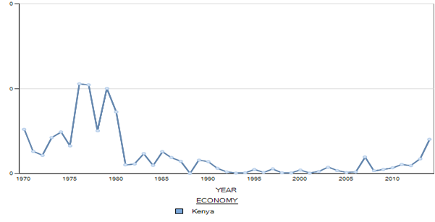
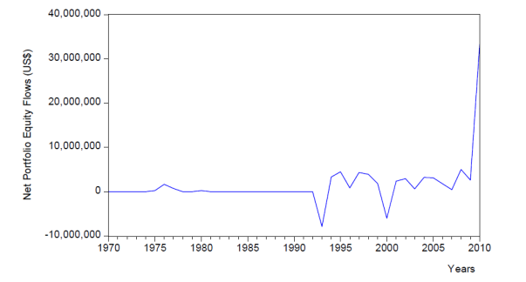
FDI and Portfolio flows Kenya

Slide 5
Objectives of the Study
The study sought to investigate the role of domestic financial sector in examining the linkages between private capital flows (foreign direct investment (FDI), portfolio investment and foreign debt) and economic growth in Kenya from 1970 to 2014.
The specific objectives of the study were;
(i)To investigate the causality between FDI, portfolio investment and cross-border interbank borrowing and economic growth.
(ii)To analyse the effects of FDI, portfolio investment and cross-border interbank borrowing on economic growth.
(iii)To examine the effects of financial development on economic growth
(iv)To assess the effect of macroeconomic variables on economic growth

Slide 6
Literature Matrix

Slide 7
Methodlogy
Research design: Non-experimental time series design.
Data types and sources: World Bank’s African Development Indicators, Kenya National bureau of statistics, Economic surveys, Statistical Abstracts.

Slide 8
Model
The effects of foreign direct investment, portfolio investment, cross-border interbank borrowing and financial development on economic growth were captured by running an ordinary least squares estimation of the following equation:

Slide 9
Results

Slide 10
FDI and economic growth
The results shows that a 10 per cent increase in the ratio of foreign direct investment to GDP will lead to an increase in GDP growth of about 7.72 percent.
This implies that foreign direct investment plays an important role in economic growth of Kenya through size effects impacting net contributions to the country’s net savings and investment, the skills and technology effects have to do with the demonstration effects and Labour migration whereas the structural effects involve competition and linkages

Slide 11
Portfolio investment and economic growth.
The coefficient of the log of portfolio investment as a ratio of GDP was positive (0.015372), it was statistically insignificant. However, a positive coefficient is a good show that portfolio investment can play an important role in the growth of the economy.
This could be as a result of Kenya having operated a closed capital account for long till 1991 when it liberalized its current and capital accounts, completely removing all restrictions on the capital account in 1995.

Slide 12
Cross-Border interbank borrowing and economic growth.
The coefficient of log of cross-border interbank borrowing as a ratio of GDP was positive (0.059199) but statistically insignificant.
This implies that cross-border interbank borrowing does not play an important role in the economic growth of Kenya. This could be because Kenya operated a closed capital account for long.

Slide 13
Financial development and Economic growth
The results showed a statistically significant relationship between financial development and economic growth.
This would mean that a minimum level of financial development must be met before a country is in conformity to attract private capital flows in pursuit of enhancing its economic growth.
A well-developed financial system provides fertile ground for the allocation of resources, better monitoring, better information symmetries, and economic growth . (King and Levine 2006).
Greater financial sector efficiency should result in an overall reduction of transaction costs. As a result, cost of borrowing (capital cost) might decline, as interest margins shrink. If these gains are being forwarded to the investors, the cost of borrowing in the markets will decline and promote investments and economic growth. (Levine 1997).

Slide 14
Response of Economic Growth to FDI
A shock in the ratio of FDI to GDP leads to a increase in the growth rate of economic growth in the second period. The rate of change of economic growth drops in the third period through the fourth period. By the fifth period, the impact of FDI fizzles out and economic growth follows its natural path.
The result implies that a shock in foreign direct investment has little short term impact on economic growth (it has an effect of less than 2 percent).

Slide 15
Response to Portfolio investment
The result indicates that a shock in the ratio of portfolio investment to GDP in the first period leads to a fluctuation in economic growth in the second period of about 2.5 percent.
The fluctuations in economic growth tend to be minimal by the seventh period.
This implies that a shock in portfolio investment has a minimal impact on economic growth.

Slide 16
Response to Cross-border interbank borrowing
Cross-border interbank borrowing leads to a decline in economic growth up to the third period. Economic growth then picks up and follows its normal growth path from the fourth period.
This shock has a negative effect on economic growth. The implication is that a shock in international lending and borrowing can negatively affect economic growth

Slide 17
Response to financial development
The shock in financial development leads to a fluctuation of less than 2 percent in rate of growth of the economy within the first five periods.
This implies that a shock in financial development has little impact and its effect is felt in the short term.

Slide 18
Effect of macroeconomic Variables
Human capital had a positive and statistically significant coefficient. A 10 percent increase in the ratio of those enrolled in secondary and tertiary institutions to total population would lead to a 6.1 percent increase in economic growth in Kenya, only countries with high levels of human capital can benefit from technological spillovers.
Macroeconomic stability had a negative and statistically significant coefficient at 10 percent. This is an indication that an unstable macroeconomic environment discourages economic growth. An increase in inflation rate by 10 percent leads to a decrease in economic growth by 0.6 percent.
The volume of trade as a share of GDP is important for developing countries.
This stresses the need for the Kenyan authorities to work with its trading partners, especially the East African Community, to remove any barriers to trade in order to accelerate economic growth

Slide 19
Recommendations
Provision of more infrastructural facilities such as construction of roads, extension and improvement of the rail services, and growth of information and communication technology to attract more FDI.
Devoting more resources to development expenditure, opening up to the global economy to tap knowledge and technology, maintain a low inflation rate, and avoid excessive debt.
Protection of investor’s rights through low taxes on capital gains and increased speed and reliability of dispute settlement systems.
Establishment of more banks and non-bank financial intermediaries translating household savings into enterprise investment and allocating funds to productive sectors in the economy leading to high economic growth.
Encourage export oriented industries so that the net exports will increase, making the country earn more foreign exchange. This will free the country from the foreign exchange gap constraint.
Funding for the education sector by constructing more classrooms, providing children with school uniform, providing sanitary towels to girls. Educated labour force would contribute to the economic growth of the country because that it has more skills and is thus more productive

Slide 20
Conclusions-Areas for Further Research
This study did not investigate the interaction between private capital inflows and the other variables: for example, FDI and remittance, FDI and openness as explanatory variables in the estimation of the effect of private capital inflows on Kenya’s economic growth.
A study that will include the interaction of these variables as explanatory variables of economic growth will complement this study.
This will inform policy makers in deciding whether they need to pursue joint or separate policies regarding the variables which determine economic growth.

Slide 21
THANK YOU

