Slide 1
CONTRIBUTION OF HIV AND AIDS CURRICULUM MAINSTREAMING TO KENYAN UNIVERSITY STUDENTS’ HIV RISK PERCEPTION AND BEHAVIOUR
By
Dr MARGARET MUKOYA IMMONJE

Slide 2
PRESENTATION OUTLINE
Background: Statement of Problem, Research Objectives,
Materials and Methods
Findings
Conclusions
Recommendations

Slide 3
BACKGROUND
HIV and AIDS still remain substantial health challenges especially in Sub Saharan Africa (UNAIDS 2014).
UNAIDS, (2015, highlighted that sexual behaviour risk is increasing esp. in young people, hence the need to intensify support for behaviour change efforts.( Similar Opinion of the Kenyan NACC Director on the 2017-AIDS day)
UNAIDS (2012), cited curriculum efforts to fight HIV as a tool for expanded HIV and AIDS response in universities in sub-Saharan Africa.
Increased HIV and AIDS knowledge has been associated with increased HIV risk perception and that HIV risk perception remains an effective determinant and predictor of HIV transmission (Essien et al 2007).
The impact of HIV knowledge on risk perception and behaviour behaviour remains unknown among Kenyan university undergraduate students.

Slide 4
Background cont.
The Kenya Education act 2012, underscores AIDS education for youth empowerment against the AIDS epidemic.
Kelly (2006) asserts the need to focus on development of skills needed in discussing AIDS prevention and to avoid risky behavior and HIV infection in universities of Sub-Saharan Africa.

Slide 5
Statement of the Problem
The relationship between HIV risk perception of risk and risky sexual behaviour remains poorly understood, Essien et al, (2009)
AIDS Prevention efforts in Kenyan universities do not seem to go hand-in hand with the undergraduate students’ risk perception (Hochbaum et al 1997, SIDA 2012 and Imbuga, 2007.
Empowerment through HIV knowledge has been associated with sharpened HIV risk perception hence reduced infection rate. (Adefuye et al 2009).Was this true to undergrads in universities in counties around Lake Victoria?

Slide 6
Statement of the Problem cont.
All these factor associations were yet to be assessed among Kenyan university undergraduate students in the Great Lake Victoria Counties of western Kenya where HIV prevalence is highest in Kenya.
The problem in the study was to find out the relationship between HIV and AIDS undergraduate curriculum mainstreaming (which drives the HIV and ADS knowledge), HIV risk perception and behaviour among Kenyan university undergraduate students in the counties bordering Lake Victoria.

Slide 7
Research Objectives
The overall objective was to examine the contribution of HIV and AIDS curriculum mainstreaming to the Kenyan university undergraduate students’ HIV risk perception and behaviour in the counties bordering Lake Victoria.

Slide 8
Specific Objectives
Determine the extent of HIV and AIDS mainstreaming in the universities in the counties bordering Lake Victoria in Kenya.
Determine the level of HIV Risk Perception of university undergraduate students in the counties bordering Lake Victoria in Kenya in relation to their knowledge of HIV and AIDS.

Slide 9
Research Objectives cont.
3. Examine the level of HIV Risk Behaviour of the undergraduate students in the counties bordering Lake Victoria in Kenya in relation to their knowledge of HIV and AIDS.
4. Determine the relationship between the HIV Risk Perception and HIV Risk Behaviour of university undergraduate students in the counties bordering Lake Victoria in Kenya.

Slide 10
Justification of the study
Education is said to be one of the best “social vaccines” against HIV&AIDS. (Nzioka et al, 2007).
AIDS research agenda in the 2014/15-2018/19 Kenyan AIDS Strategic Framework (KASF) in the priority Geographies and Populations; to reduce new infections to achieve vision 2030.
Theme is still recurrent in the Hyogo Framework for Action 2005-2010, (UN, 2005)for disaster risk reduction and the Sendai Framework (UN, 2015).
Creation of new knowledge and for CUE curriculum policy review especially foe HIV&AIDS curriculum mainstreaming.
Since the AAU toolkit, little or no such evaluation of HIV&AIDS curriculum mainstreaming effort has been done so this was a timely investigation.

Slide 11
Scope of the Study
Geographic Scope-Limited to undergraduate students in universities bordering Lake Victoria in Kenya; a high HIV prevalence area. (17.1%, KAIS Report 2014).
Study focus was HIV&AIDS curriculum mainstreaming associated with HIV risk behaviour and knowledge of the students in study.
HIV risk perception and behaviour were limited to sexual risk factors.

Slide 12
Materials and Methods
Study Area: The counties bordering the lake are Kisumu County, Siaya County, Homa Bay and MigoriCounties.
The study included:
Maseno University,
Jaramogi Oginga Odinga University of Science and Technology, (JOOUST)
Rongo University College and
Great Lakes University of Kisumu (GLUK).

Slide 13
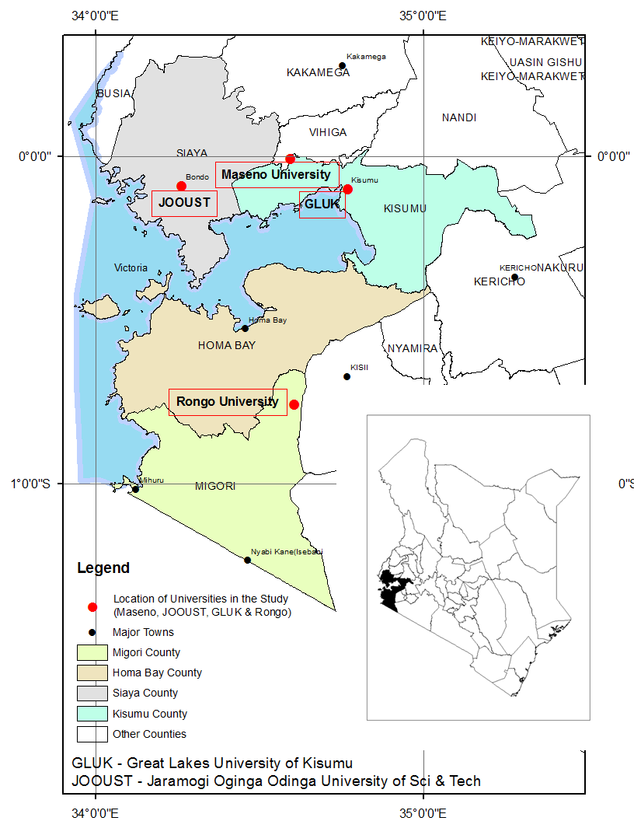
STUDY AREA MAP

Slide 14
Study Population
The study’s units of observation were the universities in counties bordering Lake Victoria, and
The units of analysis were 384 undergraduates drawn from the universities selected for the study.
4 academic registrars (who are the custodians of all university curricula HIV&AIDS included),
4 ACU coordinators and/or Deans of Students (who are in charge of counseling and coordinating Students’ activities relating to HIV and AIDS)
9-13 Student FGD discussants (men and women included)

Slide 15
Sampling Strategy(multi-stage)
Purposive sampling to select the four universities studied.
Quota sampling to determine the number of students to be studied in each university.
Systematic random sampling (every fifth student)to identify those who would fill in the questionnaires.
Key informants and Focus group discussants were also purposively selected.

Slide 16
Sample Size
The sample size for the study (n) was calculated using the formula proposed by Fisher, Laing and Stoeckel (1983).
It produced a desired sample size of 384 and 96 students per university studied.

Slide 17
Methods of analysis
Descriptive narratives,
Content analysis,
Descriptive statistics
Pearson Chi-square of association

Slide 18
Research Designs
Extent of curriculum mainstreaming in each of the four universities studied----Descriptive survey
Determine the level of HIV Risk Perception of university undergraduate students around Lake Victoria in Kenya in relation to their knowledge of HIV and AIDS----Associational
Examine the level of HIV Risk Behaviour of the undergraduate students in relation to their knowledge of the HIV and AIDS-----Associational
Determine the relationship between the HIV Risk Perception and HIV Risk Behaviour of the university undergrads------Associational

Slide 19
Results and Discussions
FINDINGS ON: 1st OBJECTIVE; 10-Point Scale Adherence criteria of the extent of HIV&AIDS mainstreaming in the universities in the counties bordering Lake Victoria in Kenya.
Rongo University College 40%
GLUK 50%
JOOUST 80%
Maseno University 80%

Slide 20
RESULTS ON 2ND OBJECTIVE
The level of association between HIV Risk Perception and knowledge of university undergraduate students in the counties bordering Lake Victoria in Kenya .
X²(384,3df) = 3.187}, at α=0.05 showed that there was an association between the students HIV risk perception and their HIV&AIDS knowledge.
The association was weak using the Phi/Cramer’s v (9.1%), p=0.364 The finding was in agreement with results in reviewed literature such as Durojaiye (2009), Nwokoji et al (2003) and Akwara et al (2003) on the inconsistency of variable association

Slide 21
RESULTS ON 3RD OBJECTIVE
Level of Association between the university undergraduate Students’ HIV Risk Behaviour in Relation To Knowledge in the study area.
{X²(384,5df) = 7.859, p=0.143}, at α=0.05 showed a fairly weak relationship between the students HIV risk behaviour and their HIV knowledge. Phi / Cramer’s v. (14.3%), p=0.164 in a 2-sided test.

Slide 22
Findings On 4th Objective
Association between the students’ risk perception and behaviour
The results {X²(384,15df) = 88.604, p=0.000}, at α=0.05 showed a strong and direct association between the students HIV risk perception and behaviour.{ Phi / Cramer’s v (27.7%), p=0.00 in a 2-sided test}.
The strength of the relationship between the students’ risk perception and behaviour confirmed a direct association in percentages that were given based on the students’ risk behaviour. It also agreed with literature reviewed

Slide 23
Role of Intervening factors on Students’ HIV risk perception and Behaviour (Finding)
Role of year of study(X²(384,15df) = 26.39, p=0.034}, at α=0.05, Phi / Cramer’s v (19.1%), p=0.034) in a 2-sided test –fairly strong and significant.
Role of Peer Pressure (X²(384,15df) = 26.391, p=0.033}, at α=0.05, Phi / Cramer’s v (19.1%), p=0.0.033) in a 2-sided test (also significant)
Role of Gender X²(384,15df) = 12.92, p=0.024, }, at α=0.05, Phi / Cramer’s v (18.4%), p=0.024) in a 2-sided test. ( a fairly strong association)

Slide 24
Other Intervening Factors Found associated with HIV Risk Behaviour in the study with weak association
Marital status
Religious Faith
Ethnicity
Morbidity and Mortality effect to the students

Slide 25
Conclusions by Study Objectives
Studied universities have mainstreamed HIV and AIDS into their curricula at varying extents (40%, %50%, 80% and 80% respectively)
A Fairly weak association was found between students HIV risk perception and their HIV knowledge.(due to the many other contributors which agrees with Zanna and Rampel reviewed)
A similar weak association was found between students HIV risk behaviour and knowledge

Slide 26
CONCLUSION Cont.
4) A strong and direct association found between students’ risk perception and behaviour hence a strong predictor of HIV infection therefore the former predicts the latter and in agreement with literature reviewed.
5) Some Intervening variables have stronger association with HIV risk behaviour than mainstreamed knowledge e.g. Year of study, Peer pressure and gender. (In agreement with literature reviewed)

Slide 27
Overall Conclusion
HIV and AIDS mainstreamed education of Kenyan university undergraduate students in counties bordering Lake Victoria contributes to reduce HIV risk behaviour (A social Vaccine Indeed).
The weak association between the key variables and HIV knowledge probably stems from the effect of the many “Intervening variables” in the study which need further in-depth research.

Slide 28
RECOMMENDATIONS
Encourage all Kenyan universities to have a well designed HIV&AIDS common course in their curriculum to sharpen their HIV risk perception hence reduce HIV risk behaviour and infection. Similarly to standardize the mainstreaming efforts targeting all first years.
HIV knowledge relating to HIV risk perception and behaviour should be inculcated using a variety of interesting methods including peer educators for better impact in well conceived HIV&AIDS common courses in the universities. The E-platform(on-line classes) should ease the pressure of student large numbers for the HIV and AIDS multi-disciplinary common courses.

Slide 29
Recommendations For Further Research
Carry out extensive in-depth studies of HIV&AIDS curriculum mainstreaming in all Kenyan universities and its efficacy on students’ attitude change from risk-taking to safe behaviour to stem HIV infection.
A study of socio-cultural and socio-economic factors which cause students’ HIV risk behaviour despite the HIV&AIDS knowledge they get at university need more in-depth study.
The impact of on-line HIV&AIDS education should be constantly studied and reviewed.

Slide 30
THANK YOU
END OF PRESENTATION

Slide 31
References
As indicated in the brief synopsis of the presentation

Slide 32
Presenter’s Background Margaret M. Immonje
PhD (MMUST), MEd (Kenyatta University), BA-Ed. Option (University of Nairobi) Lecturer in Geography Education, MMUST, Teacher Educator (Geography Education)at Maseno University and MMUST
Former MMUST AIDS Control Unit Coordinator (2004-2009)
KICP, Geography Panel writer , and Ministry of Education Textbook Evaluator.
Kenya National Examination Council-KNEC Examiner, Setter and Moderator of Geography examinations.
Key Publications; PhD Thesis: Contribution of HIV&AIDS Curriculum Mainstreaming to Kenyan Undergraduate Students’ HIV Risk Perception and Behaviour ( 2017).
M Ed. Research Dissertation: A comparative Study of the Factors that Contribute to Job Satisfaction and Dissatisfaction between Teachers in Private and Public Primary Schools in Nairobi Kilimani zone. Kenyatta University, 1990.
Chapter Writer; National Cohesion and Integration Commission, 2014. Mainstreaming National Cohesion and Integration in Kenya’s Educational Curriculum; Chapter 9 p 114; Proposals for Reform in the Geography Syllabus. ISBN Number: 978-9966-044-10-5.
Immonje M.M., Mauyo L.W and Shiundu J.O. (2016). Co- authors; Extent of HIV&AIDS Curriculum Mainstreaming in Kenyan Universities in the Counties Bordering Lake Victoria. Ideal Education and Policy Studies 2(5) 168-174. Ideal True Scholar (2016)(ISBN: 2067-7723) http://ijeps.trueschoalr.org

Slide 33
Presenter’s Background cont.
Immonje M.M., J. Wakhungu and J. O. Shiundu (Co-authors): Kenyan University Undergraduate Students’ HIV Risk Behaviour and Knowledge in Counties Bordering Lake Victoria. InternationalJournal of Social Sciences and Humanities’ Research. ISBN 2248-3164 Vol. 4, pp. (313-318), October-December 2016. www.researchpublish.com
Book Review pg. 1999 of, Ogot Bethwell A.: Politics and the AIDS Epidemic in Kenya 1983-2003; Kisumu; Anyange Press Ltd; 2004; 185 pp. By Margaret M. Immonje. In J-STEM VOL.1 No.1 JANUARY 2007. ISSN 1991-2889 Co-author and coordinator of the Masinde Muliro University of Science and Technology (2008)
HIV and AIDS Work and Study Place Policy. MMUST, Azingo Enterprises Limited.vc@mmust.ac.ke
Commission for Higher Education. (2004). Training of Heads of Sub-AIDS Control Units. Proceedings of a workshop held from June 28th to July 2nd, 2004. See page 31, where the Western University of Science and Technology report by M. M. Immonje, Chairperson, and WUCST ACU Sub-unit is found.
Immonje M.M. (2007). Report of the Deliberations of the Inter University Council of East Africa-IUEAC/ African Medical Research Foundation-AMREF. Lake Victoria Partnership (IUCEA/AMREF Planning Meeting held at Speke Resort, Muyonyo, Kampala-Uganda.
SIDA (2010) EAC/AMREFLAKE VICTORIA Partnership (EALP) Programme “Addressing Mobility, Vulnerability and Integrated Response to HIV&AIDS in the Lake Victoria Basin”. (I was instrumental in the successful lobbying for MMUST inclusion in Six other East African Universities and my own participation, in the research hence the regional report above).

