Slide 1
CONTRIBUTION OF DEVOLVED GOVERNANCE ON HEALTH SYSTEMS CAPACITY TO PROVIDE HEALTHCARE SERVICES IN KAKAMEGA COUNTY, KENYA WANZALA N. MAXIMILA

Slide 2
Application of Principal Component Analysis to assess health systems capacity using cross sectional data in rural western Kenya
Maximila N. Wanzala, J.A Oloo and Gordon Nguka
(American Journal of Public Health Research Paper ID: 1000112531)

Slide 3
BACKGROUND OF THE STUDY
Worldwide health systems are facing an increasing number of challenges, while governments remain dedicated to searching for cost-effective options to enhance the capacity of national health systems to perform well.
Health workforce, procurement, supplies and financing are essential for effective service provision.
Health is crucial for attaining the sustainable development goals (SDGs), and it's also a measure of the progress of a nation towards achieving sustainable development.

Slide 4
BACKGROUND OF THE STUDY cont’
SDG 3: To ensure healthy lives and promote well being for all at all ages
Vision 2030, Health pillar :
To provide an efficient integrated and high quality affordable health care system
To prioritize preventive care and community and household level, through a decentralized national health-care system
To devolve funds and decision making to the county level and retain policy and research issues

Slide 5
Problem Statement
Devolution of health care in Kenya since the enactment of the new constitution in 2010 and 2013 national election was aimed at ensuring health care was more improved, more efficient and available for all citizens at affordable cost.
However, inadequacies in national governments still exist in the devolved government(Taylor & Aaron, 2015)
There is little published evidence of performance of health indicators especially using advanced analytical methods such as principal component analysis to monitor progress towards achieving the SGD 3 in Kakamega County.

Slide 6
Why Kakamega?
The study was in Kakamega County because it happens to be among those counties that have the worst health indicators in Kenya
Since 2013 the health care was devolved yet health indicators in Kakamega county were still amongst the worst in 2014.
Health care financing :NHIF coverage was at 30% in Kakamega county Vs 27% in Kenya in 2014
Health personnel: Clinical officers was 22 per 100,000 people in Kakamega Vs 21 per 100,000 people in Kenya
Skilled birth delivery was 47% in 2014 compared to 61% at national level(MOH, Kakamega Fact Sheet, 2015)
Nutrition –stunted growth 28% in Kakamega Vs 26% in Kenya

Slide 7
Purpose of the study
The purpose of the study is to disseminate findings and advise policy on the devolved governance concerns that need to be addressed in order to strengthen healthcare service delivery that will be sustainable for development.
(service delivery, Medical supplies, health financing, health workforce and health leadership and governance, Health information system)

Slide 8
STUDY OBJECTIVES
Overall Objective
To assess the contribution of devolved governance on the capacity of the health systems to provide service delivery in Kakamega county

Slide 9
RESEARCH METHODOLOGY
Study design: cross sectional study
Study area: Kakamega County
Study population: 132 health facilities within Kakamega county
Sampling technique: Multi- stage cluster sampling,
Inclusion Criteria : Where consent was provided
Sample size determination : Applied WHO and SARAM formula(WHO 2015)

Slide 10
PCA Model
Where a₁₁ a_{12 ….} a_{1n} represents the weight for the first principal component (coefficient in linear regression)

Slide 11
RESULTS

Slide 12
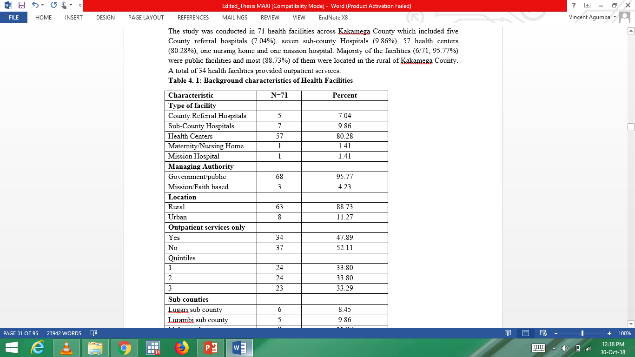
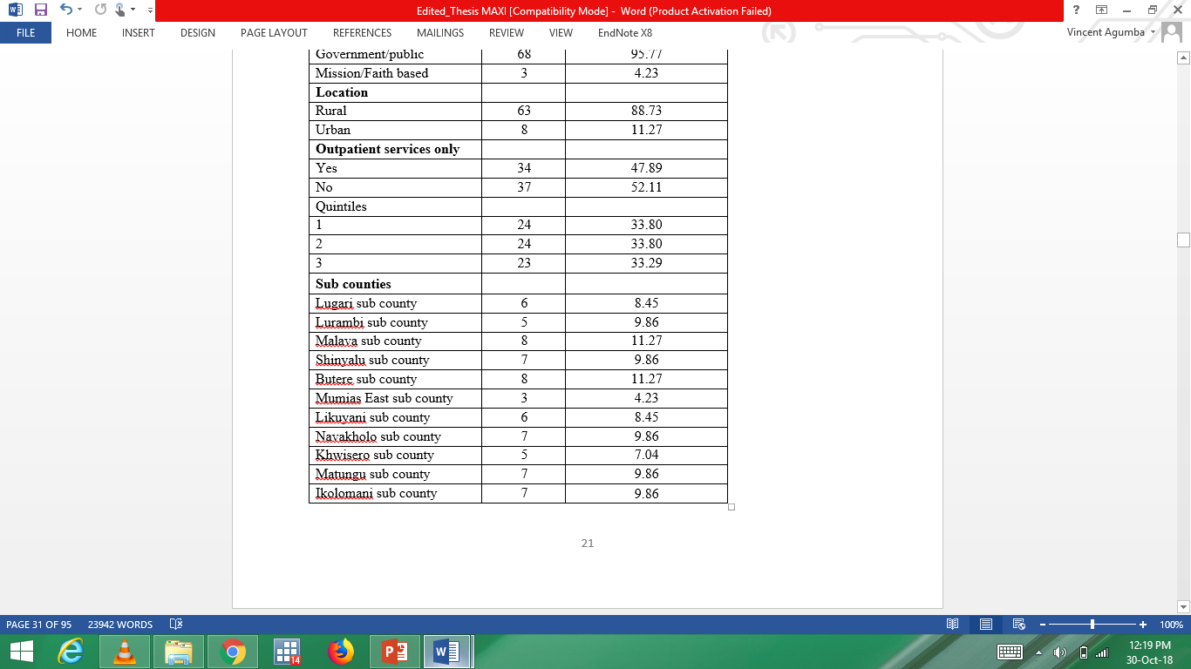
Background characteristics of Health Facilities

Slide 13
SERVICE DELIVERY
Top ten Ranked health system performance indicators
Rank | Indicators | Weight
1 | Functioning Microscope for malaria smear test | 0.1492
2 | Routine inpatient care | 0.1477
3 | Availability of Giesma or field stain | 0.1459
4 | Providers in the facility diagnose and/or manage diabetes in patients | 0.1452
5 | Availability of Microscope | 0.1448
6 | Availability of dipstick or urine protein (with valid expiration date) | 0.1441
7 | Availability of dipstick or urine glucose (with valid expiration date) | 0.1402
8 | The facility accept use of NHIF | 0.1402
9 | Availability of dipstick or urine ketones (with valid expiration date) | 0.1380
10 | Functioning computer | 0.1370

Slide 14
Ranking of health facilities in terms of performance in service delivery:TOP 10
Rank | Health facility | Weight
1 | Malava County Hospital | 7.795616
2 | Lumakanda County Hospital | 7.745506
3 | Butere County Hospital | 7.489488
4 | Likuyani Sub-County Hospital | 7.029949
5 | Iguhu County Hospital | 6.473959
6 | Matungu Sub-County Hospital | 5.864470
7 | Kakamega County Referral Hospital | 5.685230
8 | Khwisero Health Center | 5.636080
9 | Mantala Sub County Hospital | 5.172966
10 | Navakholo Sub County Hospital | 4.967756

Slide 15
Medical Supplies indicators
Rank | Indicators | N | Percent | Weight
1 | Insulin injection | 13 | 18.31 | 0.1297
2 | Metformin cap/tab | 13 | 18.31 | 0.1222
3 | ACE inhibitor (e.g. enalapril) | 20 | 28.17 | 0.1135
4 | Quinine injectables | 23 | 32.39 | 0.108
5 | Atenolol (Beta-blockers) | 13 | 18.31 | 0.1048
6 | Thiazides | 20 | 28.17 | 0.103
7 | Calcium channel blockers (e.g. amlodipine) | 18 | 25.35 | 0.0923
8 | Glibernclamide 5mg cap/tab | 17 | 23.94 | 0.0894
9 | Asprin cap/tab | 34 | 47.89 | 0.0752
10 | Frusemide 40mg tab | 34 | 47.89 | 0.075

Slide 16
Medical supplies and equipment: TOP 10
Ranking of Health facilities according to performance in Medical supplies.
Rank |  | Health facility | Weight
1 |  | Iguhu County Hospital | 5.941366
2 |  | Matunda Sub County Hospital | 5.899018
3 |  | Bushiri Health Centre | 5.378592
4 |  | Navakholo Sub County Hospital | 5.163315
5 |  | ACK Namasoli Health Centre | 4.998361
6 |  | G.K Prison Dispensary Kakamega | 4.890550
7 |  | Mantala Sub County Hospital | 4.486242
8 |  | Kakamega County Referral Hospital | 4.452241
9 |  | Elwesero Health Centre | 4.043912
10 |  | Khwisero Health Center | 3.555093

Slide 17
Healthcare financing: indicators

Slide 18
Ranking of Health facilities according to health care financing:TOP 10

Slide 19
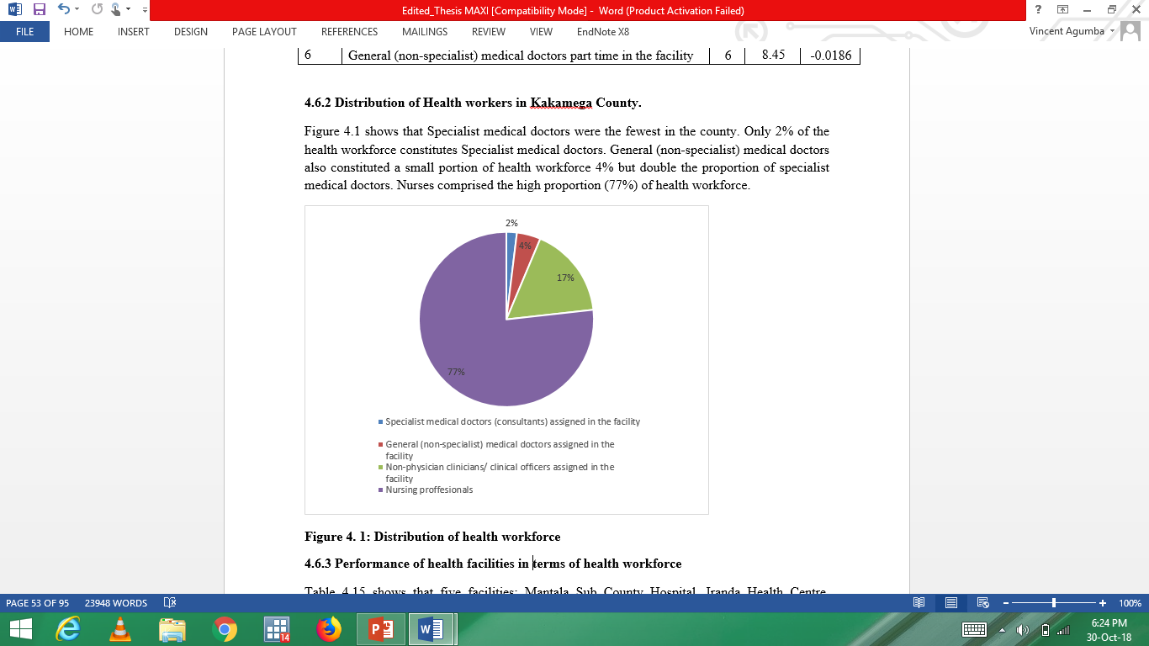
Distribution of Health workers in Kakamega County

Slide 20
Ranking of overall Health facilities: TOP 10

Slide 21
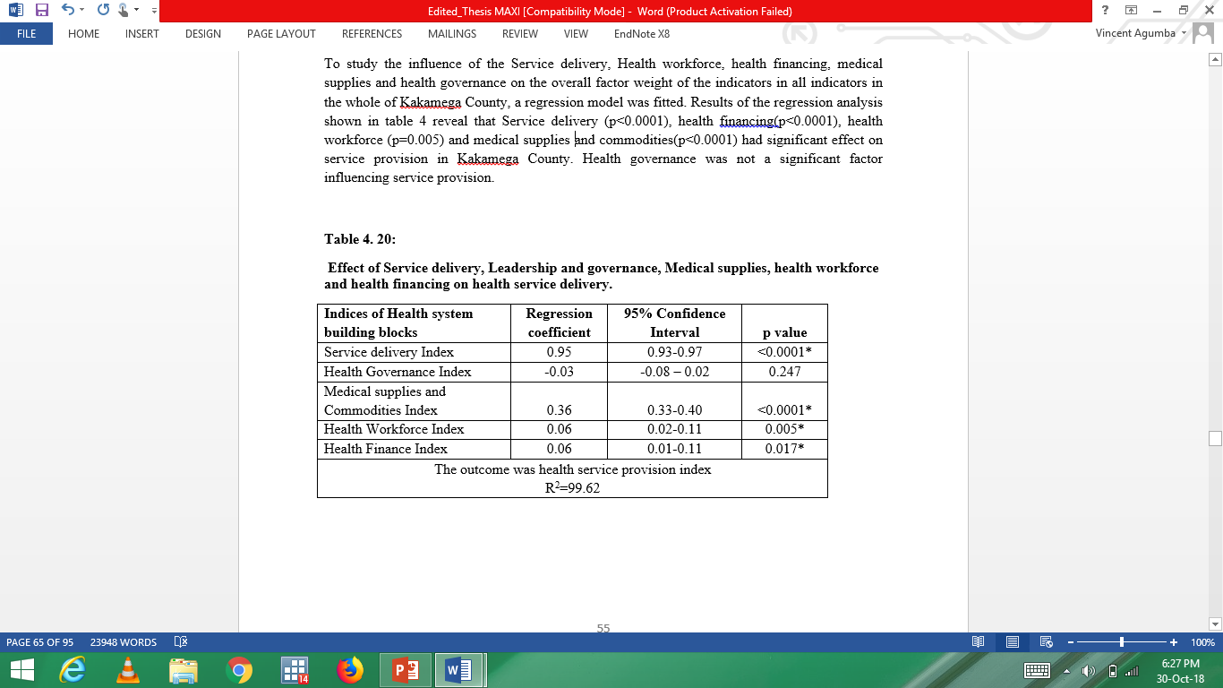

Slide 22
Conclusions
This study established that service delivery was the best performing health system building block compared to health workforce, health financing, health governance and medical supplies in a devolved government environment.
On medical supplies and commodities, Insulin injection had the highest impact factor followed by metformin cap/tab then ACE inhibitor.
Among the health system building blocks that significantly influenced service provision were service delivery, health workforce, and health financing and medical supplies.
This is the first study to the best of the knowledge of the researcher to apply principal component analysis to analyze health system performance in a devolved system Kakamega.

Slide 23
Recommendations of the study
Recommendation for Policy
The government should strengthen legislation on use on efficient employment policy to avoid blotted works force.(workforce)
The increased availability of funding to the county government should be sustained and bottlenecks removed to ensure counties are in charge of funds.(Finance & governance)
Revision of policies and by-laws should be enhanced to ensure policies are based on data.
(HIS &Governance)
Stakeholders should be continuously engage to address the poor performance sectors.
(Governance)
Recommendation for Practice
A future study should conduct a quasi-experimentation study to compare data between counties, with a baseline and end line periods.
Health systems capacity evaluation to be continuously done

Slide 24
PUBLICATIONS
Assessing capacity and performance of health systems using principal component analysis: Results from cross sectional survey in Kakamega County, Western Kenya
Maximila N. Wanzala, Vincent Were, J.A Oloo and Gordon Nguka
( Journal of Health, Medicine and Nursing, ISSN 2422-8419)
2.Application of Principal Component Analysis to assess health systems capacity using cross sectional data in rural western Kenya
Maximila N. Wanzala, J.A Oloo and Gordon Nguka
(American Journal of Public Health Research Paper ID: 1000112531)

