Slide 1

Moistube Irrigation: Is It a Solution to Water –Food – Energy Nexus problem?
Edwin Kanda

Slide 2
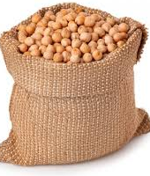
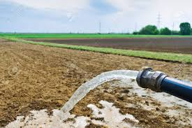
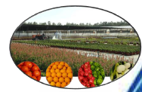
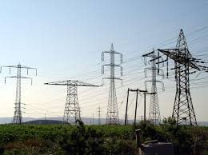
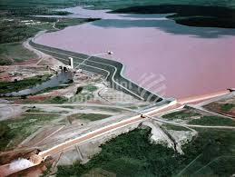
Introduction
70% of global water withdrawals
75% of industrial water withdrawals is used for energy production
The food production and supply chain accounts for about 30% of total global energy consumption
UN_Water(2014)

Slide 3
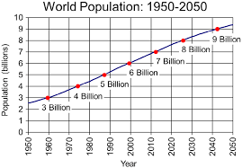
Introduction
Kenya’s Current population stands at 48.5 Million and;
17.3 Million live below poverty line (USD1.9/day)
29% of Children are stunted
67% of households use biomass energy for cooking
Population projected to hit 95 Million by 2050
  Double food production
  Expand clean and affordable energy supply
  Enhance water provision
(Source: Thatcher, et al , 2017)
By 2100, 80% of world population will be in Africa or Asia (UN, medium variant data, 2015)

Slide 4
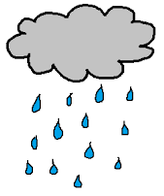
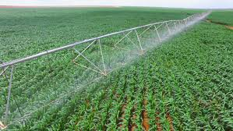
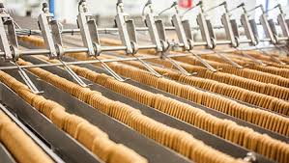
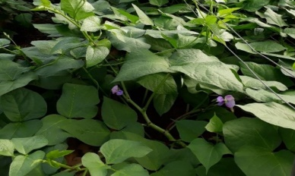
Water – Food
Virtual water
Reinders (2018)

Slide 5
Water – Food (Kenyan context)
Kenya is 84% Arid and semi-arid
The irrigation potential is 1.3million Ha
Kenya is classified as water scarce (annual per capita water availability of 547m³)
Therefore, we need better water resources management
125,000 hectares (about 10%) is currently under irrigation
43% smallholder irrigation
(KIPPRA, 2018)

Slide 6
Energy – water
Energy is needed to provide water
Energy production need water
What is the impact of Hydropower generation on water sources?
(Reinders, 2018)

Slide 7
TECHNOLOGY
How can we produce more food using less water and minimum energy?
Appropriate technology is necessary

Slide 8
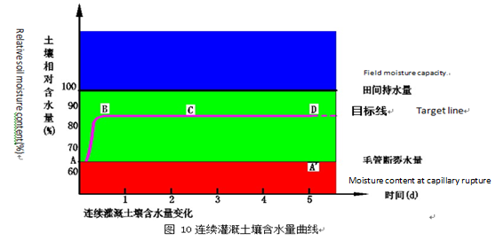
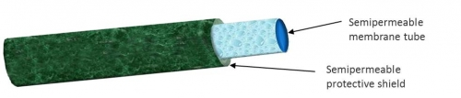
Moistube Irrigation (MTI)
Moistube irrigation (MTI) is a new technology which originated in China
  Trials in China, UAE, Morocco (Green Engineering Mission)
The system uses semi-permeable membrane
Supplies water at 80 – 90% FC throughout the cropping cycle
Continuous irrigation at near FC
Water content %
Moistube structure
Field capacity
(Envirogrower, 2017; Yang, 2016)
Time (days)

Slide 9
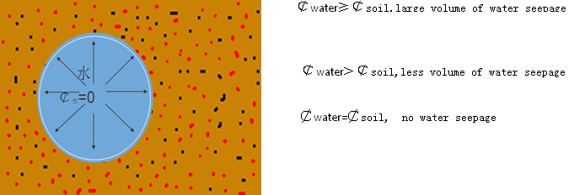
Working principle
The discharge from Moistube varies with;
System pressure
Soil water potential
(Yang, 2016, Niu et al., 2017)
Kanda, et al. (2018)
The effect of soil water potential is weak (< 48 hours)

Slide 10
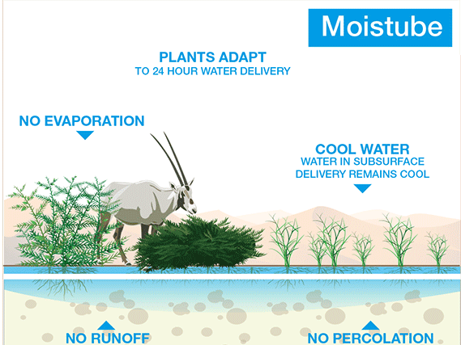
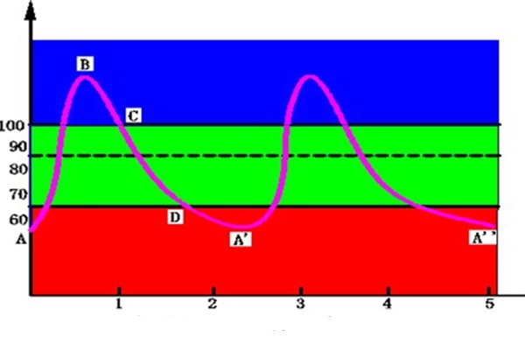
Moistube Irrigation…
High energy savings
Water savings
Low operation cost
Moistube irrigation
Typical drip irrigation
Water content (%)
FC
Water content (%)
Target line
Time (days
Crop suffer some stress
No water stress
(Lyu et al., 2016, Envirogrower, 2017, Yang, 2016, )

Slide 11
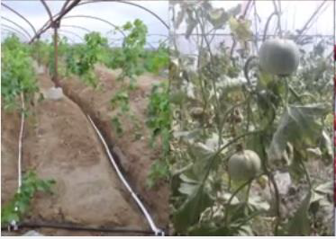
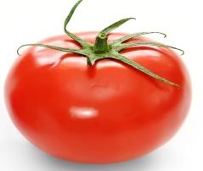
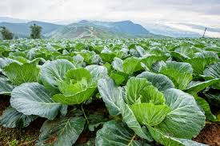
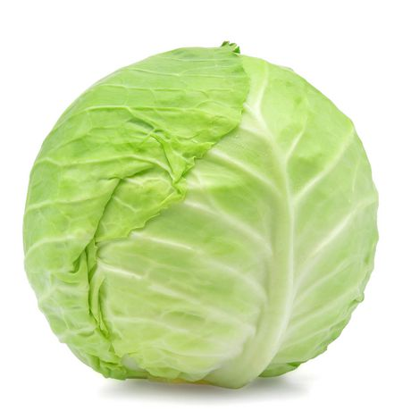
Crop performance under MTI
1) Tomato
  Relatively same yield, 38% water savings and WUE (↑13 – 26%), than drip irrigation
2) Cabbage
No significant improvement in yield compared to drip irrigation – validation of water savings failed
Xue, et al., 2013; Lyu, et al., 2016; Zhang, et al., 2017; Sun et al., 2018)

Slide 12
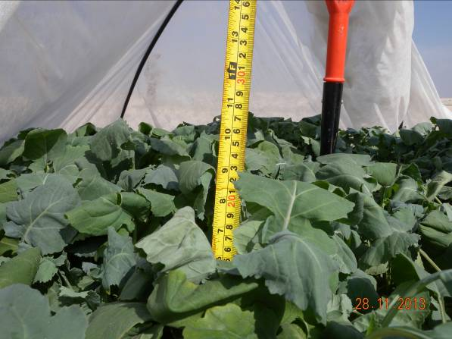
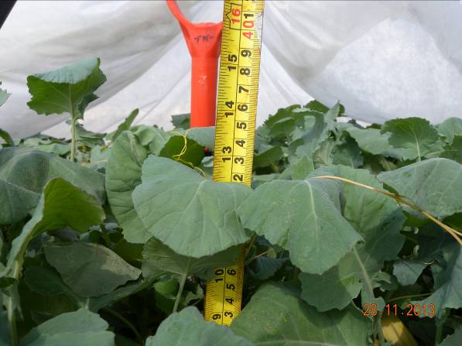
Crop performance under MTI…
3) Black mustard (Brassica Nigra)
MTI
Plant height = 34 cm
Drip
Plant height = 23 cm
(Yang, 2016)

Slide 13
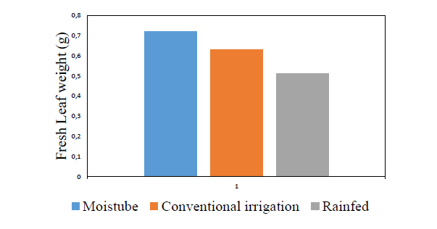
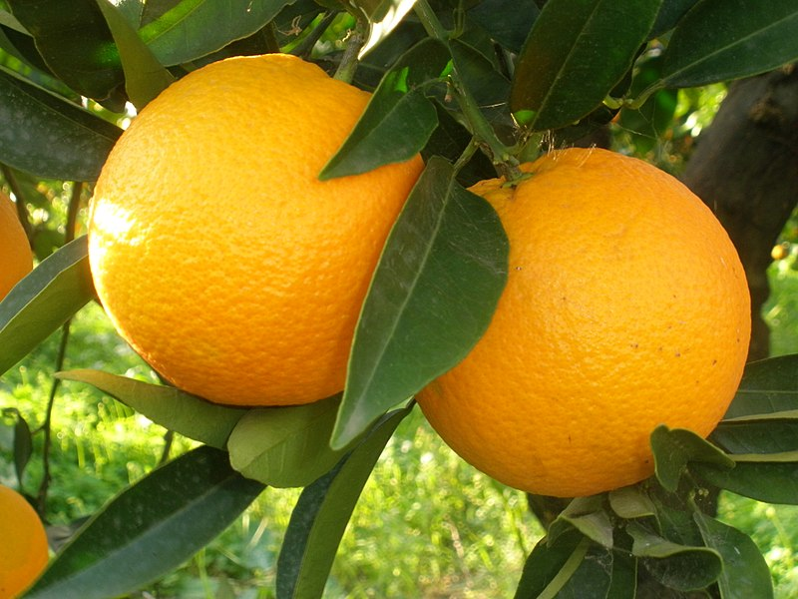
Crop performance under MTI…
4) Naval oranges
Highest leaf respiration index, photosynthetic rate, specific leaf weight and quantum yield
(Yao, et al, 2014; Yang, 2016 )

Slide 14
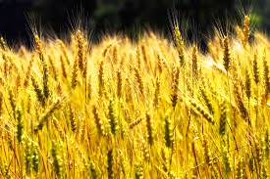
Crop performance under MTI…
5) Winter wheat
Biomass, yield, crop & irrigation WUE ≈ drip irrigation
Water savings = 25%
(Zhang, et al., 2018)

Slide 15
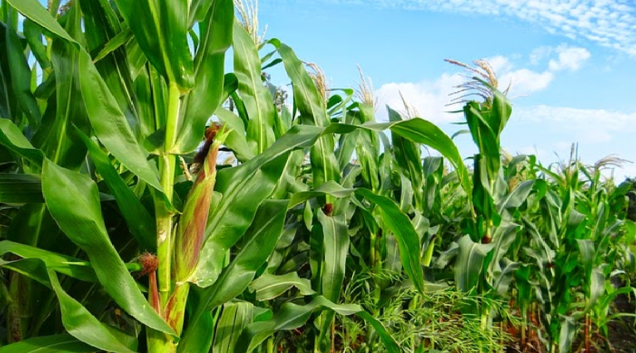
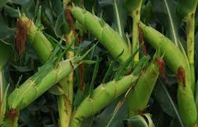
Crop performance under MTI…
6) Maize
Yield significantly less in MTI than subsurface drip (SDI)
WUE not significantly different between SDI and MTI
(Zhang, et al., 2018)

Slide 16

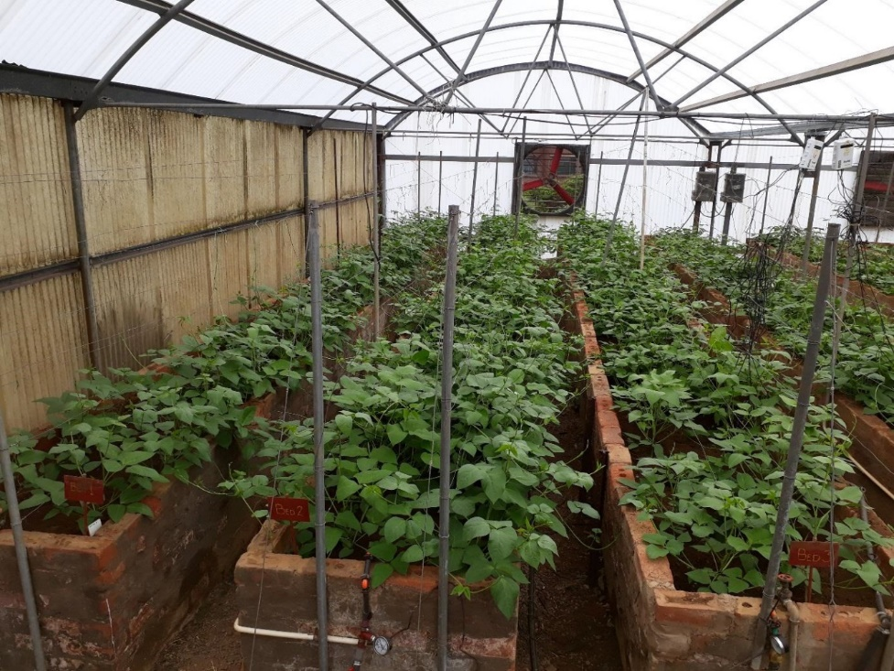
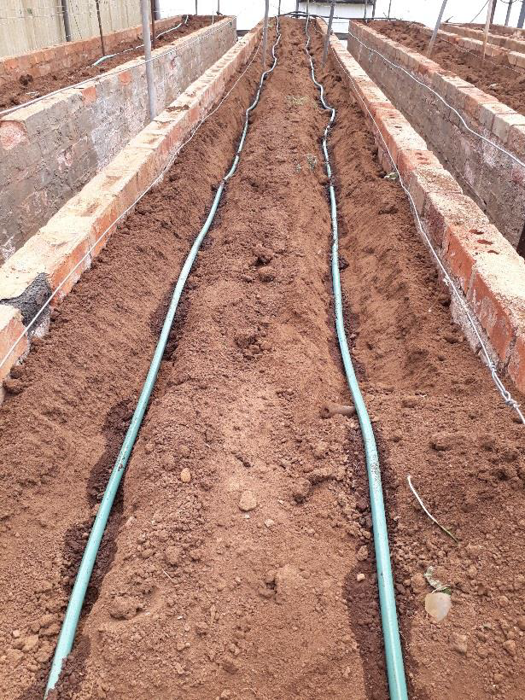
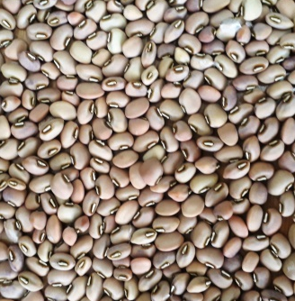
Crop performance under MTI…
6) Cowpea
Leaf area index, Biomass and grain yield ≈ subsurface drip irrigation
Irrigation WUE ≈ subsurface drip irrigation
Moistube tapes
Experiments at University of KwaZulu-Natal, pietermaritzburg Campus, 2018

Slide 17


Is Moistube irrigation appropriate technology for sustainable agriculture?
TECHNOLOGY
Be the Judge !!!!!

Slide 18
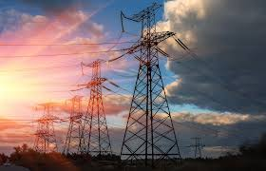
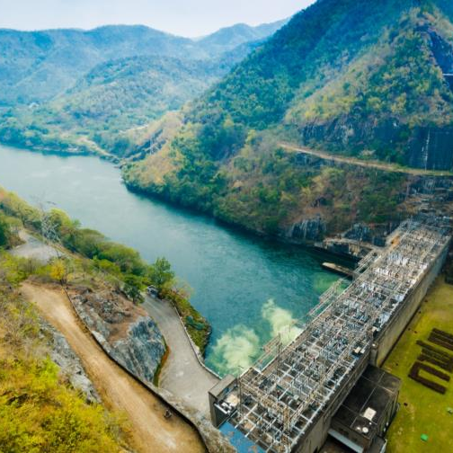
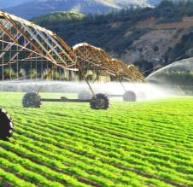
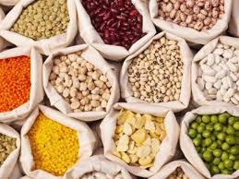
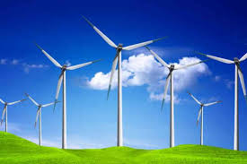
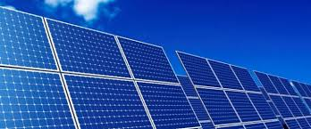
End
Thank You

