Slide 1
Nurses’ Competence on Intravenous Fluid Therapy in Under-fives with Dehydration in Kakamega County Hospitals Kenya
Roselyne Asiko Abwalaba (MSN)
SUPERVISORS
1. DR.PHILIP OGUTU
2. DR.SAMUEL NG’ARNG’AR

Slide 2
Background
  Worldwide, 20% of under-fives develop complications related to intravenous fluid therapy(Hoste et al.,2014).
  1.5million children die due to dehydration secondary to diarrhea (WHO,2009).
  In Kenya, dehydration is the second leading cause of mortality in children (UNICEF,2016).
  The under five mortality rate in Kenya is 52 per 1000 live birth which is far from the MDG of 39 per 1000 (KDHS,2014).
  In Kakamega County, dehydration is the fourth leading cause of mortality in under-fives (MOH,2016).

Slide 3
Statement of Problem
In Kenya,17% of under-fives die due to inappropriate intravenous fluid therapy yearly (KDHS, 2014).
The government spends a lot of money on free medical care for under-fives
In Kakamega county hospitals, IVF are administered on daily basis.
50% of anecdotal and empirical reports stated inappropriate intravenous fluid therapy in under-fives.
Inappropriate fluid therapy increase morbidity and prolong hospital stay (Kavutha, 2010).
Little has been done to evaluate nurses’ competence on IVF therapy, and yet they are the custodians of nursing care plan and nursing orders.

Slide 4
Broad Objective
To evaluate nurses’ competence on intravenous fluid therapy in under-fives with dehydration.
Specific Objectives
Assess the knowledge of nurses on intravenous fluid therapy in under-fives with dehydration.
Examine the practice of nurses’ on intravenous fluid therapy in under-fives with dehydration.
Analyze the factors that affect competence of nurses on intravenous fluid therapy in under –fives with dehydration.

Slide 5
Research Questions
What is the knowledge of nurses’ on intravenous fluid therapy in under-fives with dehydration?
What is the practice of nurses’ on intravenous fluid therapy in under-fives with dehydration?
What are the factors that affect competence of nurses’ on intravenous fluid therapy in under-fives with dehydration?

Slide 6
Justification
By conducting the study, the findings will:
Provide baseline information on the nurses’ competence on intravenous fluid therapy in under-fives with dehydration.
Enable hospital administration to reinforce the implementation of best practices of IVF therapy in under-fives with dehydration.
Form basis for future studies on intravenous fluid therapy in under-fives with dehydration.

Slide 7
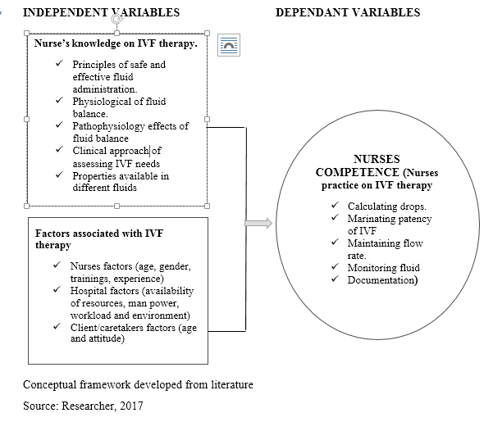

Slide 8
Research Methodology
Research design
Descriptive cross sectional study
Study Area
Kakamega County Hospitals.
Study period :10th March 2017 to 30th June 2017
Target population
All nurses who work in paediatric departments
Inclusion criteria
Nurses working in paediatric departments
Exclusion criteria
Student nurses on attachment and nurses on internship
Nurses with less than 1 year experience.

Slide 9
Sampling Procedure
Simple random sampling (Selection of facilities and individual).
Purposive sampling method (selection of departments in KCGH).
Proportionate allocation of sample size.
Validity & Reliability
Pretesting of the questionnaire was conducted at Vihiga county hospital on 20 nurses.10% of projected sample size (Conelly,2008).
Validity was ensured by expert view and feedback from pretest
Reliability test was done using cronbach alpha(checking for inter consistency) and coefficient was 0.73 for the whole questionnaire.
Research instruments
Self-administered questionnaires (Fulcher & Frazer, 2007)
Observational checklists were used (NCK procedure manual,2013).

Slide 10
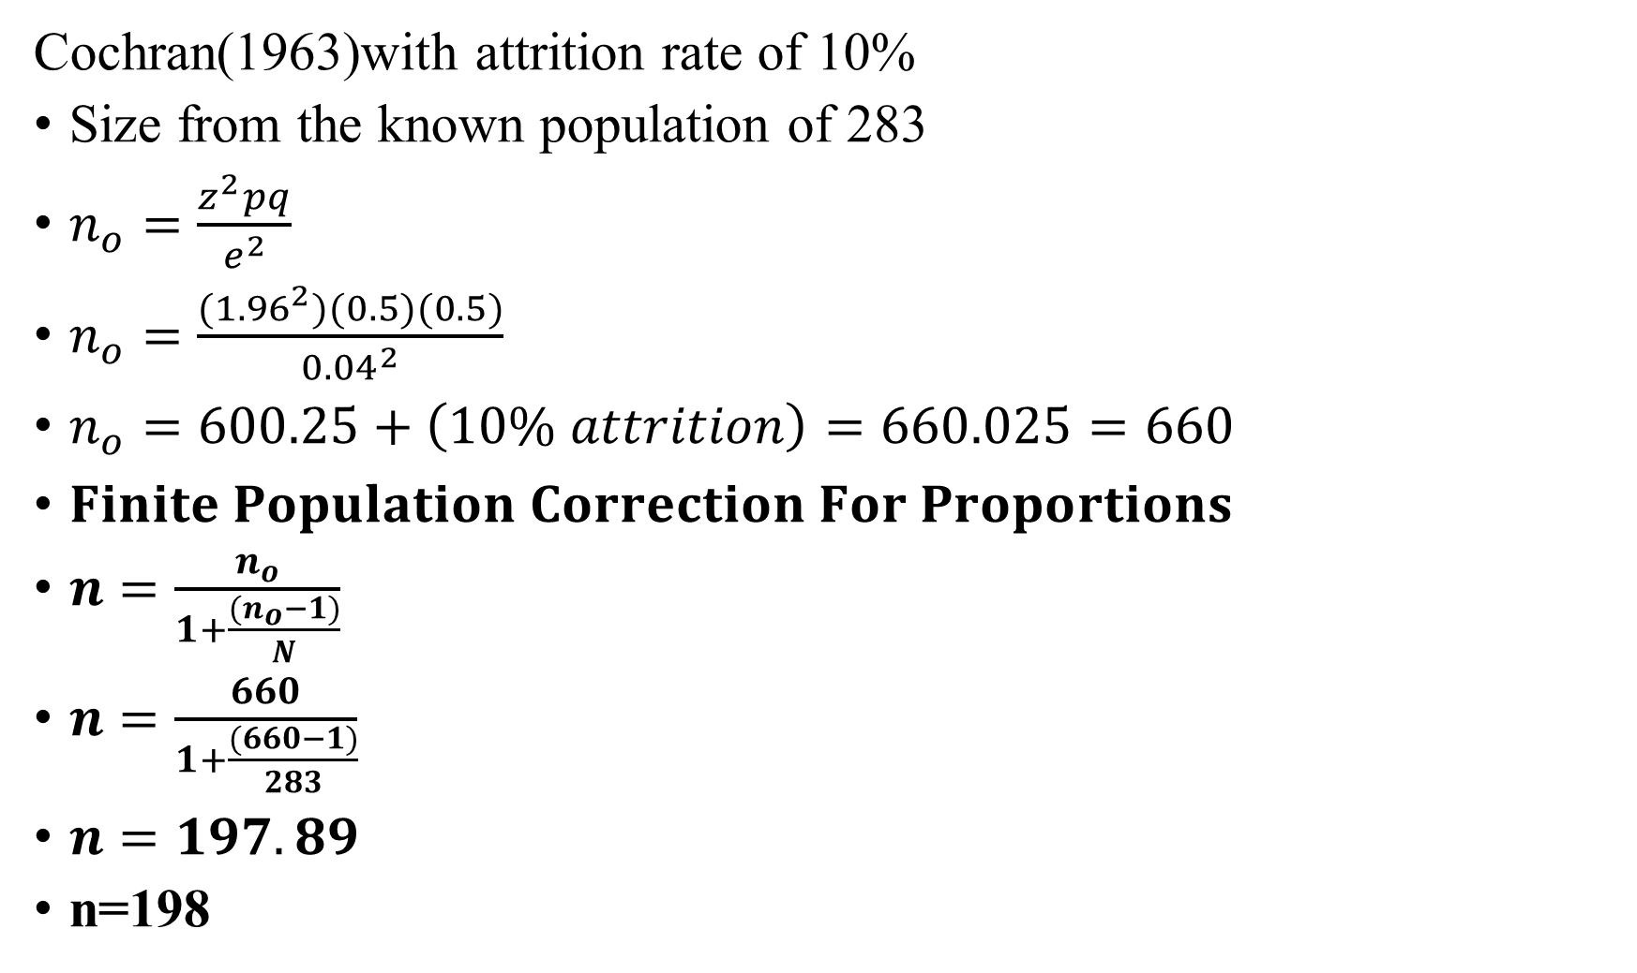
Sample Size Calculation Formulae
Cochran(1963)with attrition rate of 10%
Size from the known population of 283
$n_{o}=\frac{z^{2}pq}{e^{2}}$
$n_{o}=\frac{({1.96}^{2})(0.5)(0.5)}{{0.04}^{2}}$
$n_{o}=600.25+\left(10\% attrition\right)=660.025=660$
$Finite Population Correction For Proportions$
$n=\frac{n_{o}}{1+\frac{{(n}_{o}−1)}{N}}$
$n=\frac{660}{1+\frac{(660−1)}{283}}$
$n=197.89$
n=198
Notes:
Z=1.96 (z score for 95% confidence interval), p=0.5 (for maximum variability), e=0.04 (4% margin of error), n_{o}=estimate population sample, N=actual population, n=desired sample size q=1-p (0.5)

Slide 11
Data Analysis
Raw data checked, coded , entered and cleaned in statistical package for social sciences version 23
Computed variables of knowledge and practice, created index scores, standardized the scores.
Demographic data identified using unique index ,descriptive analysis (frequencies, percentages, means, and Standard deviation) were used.
Inferential statistics used (chi square and regression model) used to find the relationship between selected variables and practice of IVF therapy.

Slide 12
Ethical considerations
Approval from Directorate of graduate studies
Ethical clearance by MMUST IERC
Permit; NACOSTI
Permit from County Commissioner, County Director Education, County Director of Health
Justice, confidentiality, anonymity, beneficence
Informed consent
Notes:
Beneficence was observed whereby no harm was caused to any participant, whether physical, psychological, social and economic.

Slide 13
Table1: Summary of Demographic characteristics of respondents
CATEGORY | FREQUENCY | PERCENTAGE
Gender
Female | 112 | 56.0
Age group
30-39 years | 106 | 53.0
Religion
Christian | 160 | 80.0
Marital status
Married | 118 | 59.0
Training Institution
Public | 141 | 70.5
Year of Qualification
2001-2010 | 73 | 36.5
Level of education
Diploma | 101 | 50.5
Experience
1-3 years | 111 | 55.5

Slide 14
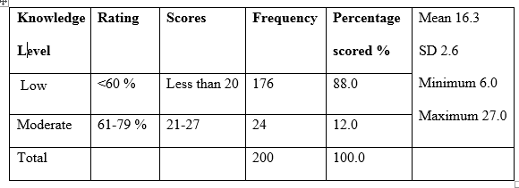
Results: Objective 1
Table 2: To assess the knowledge of nurses’ on intravenous fluid therapy in under-fives with dehydration

Slide 15
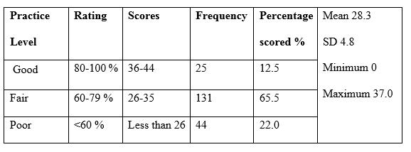
Results: Objective 2
Table 3: To examine the practice of nurses on intravenous fluid therapy

Slide 16
Results: Objective 3 Factors affecting nurses competence on IVF therapy
Trainings was the major factor that affected competence of nurses(84%) on intravenous fluid therapy
75.8% of the nurses indicated availability of resources as a factor that affected their performance of intravenous fluid therapy.
66.6% of nurses mentioned workload as a factor that affected their competence on intravenous fluid therapy
Motivation (10.5%) and conducive environment(14.5%) least affected nurses competence on intravenous fluid therapy.

Slide 17
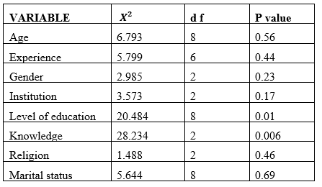
Relationship between different variables and practice of IVF

Slide 18
Discussion: objective 1
This study observed that nurses had low level of knowledge on IVF therapy which concurs with a study that was done in India by mogisleewi & Grace,2016 which found out that nurses had low level of knowledge in the management of intravenous fluid. Hence recommended that a study to be conducted on a larger sample size.
This study concurs with a study that was conducted by (Pradeep,2010) in Ireland on high volumes of IVF which increased mortality and was associated with inappropriate practices of nurses in management of children and adults on intravenous fluids.
The study findings of nurses having low level of knowledge on IVF therapy contradicts with a study that was carried out in India by (Vijayan,2011) which found out that 50% of nurses had knowledge above average.

Slide 19
Discussion: Objective 2
The study findings concurs with a prospective study that was carried out in Australia by Han et al.,2010 which observed that, the most common error caused by nurses was wrong administration rate of IVF.
The study findings also concur with the similar study conducted in India on nurses practice on IVF which portrait that most nurses had an average score of practice (Vijayan, 2011).

Slide 20
Discussion: Objective 3
The study findings of training being the major factor affecting nurses competency on IVF concurs with a study that was carried out in Texas which stated that lack of trainings on IVF by nurses contributed to poor practices of IVF therapy in children (Jacobson et al., 2005).
Relationship between different variables with IVF practice
This study finds a significant relationship between the level of education and knowledge with the practice of nurses on intravenous fluid therapy with a p<0.05.
There was no significant association between age, experience and practice in IVF with p>0.05. This contradicts with a study that was carried out by Jacobson et al., 2005 which showed that older nurses with more experience had successful IVF practice than there younger counter parts with less experience.

Slide 21
Conclusion
The study concludes that:
Nurses had low level of knowledge on IVF therapy
Nurses had moderate level of practice on IVF therapy
Trainings, availability of resources and workload are the major factors affecting competence of nurses on IVF therapy.
There was a significant relationship between level of education and experience with IVF in under-fives with dehydration with p<0.05.

Slide 22
Recommendations
The hospital management through the chief nurse to initiate on job and short term trainings for nurses on IVF therapy.
Hospital board to strengthen supportive supervision programs for IVF therapy.
Future research to be conducted in private hospitals and other county hospitals.

Slide 23
Acknowledgement
I thank God for the far He has brought me.
My supervisors Dr. Philip Ogutu and Dr. Samuel Ng’arng’ar.
School of nursing staff for their support
My two research assistants.
My husband and my children for their support
God bless you all.

Slide 24
Dissemination of the findings
County government stakeholders given the initial results on 30th January 2019
TNA to be conducted by support of partners
Funds to be solicited
Training for nurses to be initiated on IVF in under –fives

Slide 25
Thank you

